Slide 1
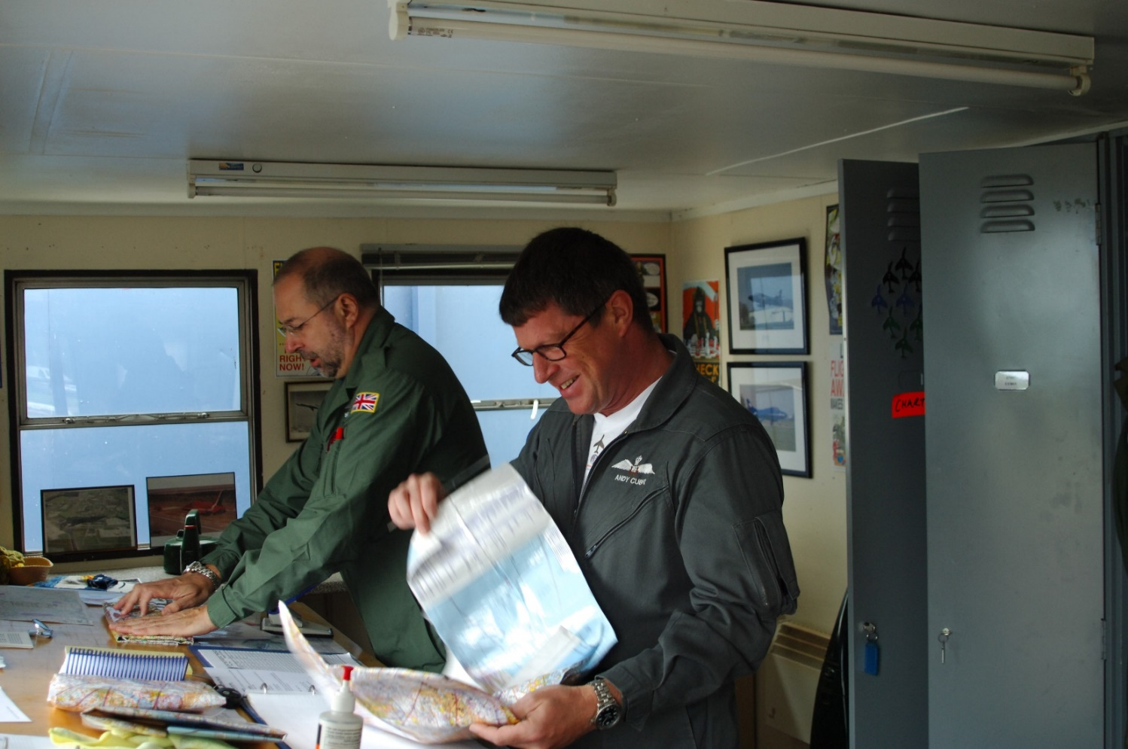
Flight Planning
Steve Male 30th April 2020

Slide 2
What is it?
Flight Planning
Flight planning is the process we go through to:
Decide what flight we will attempt
Think about contingencies
Carry out all the necessary pre-flight preparation
Prior Preparation Prevents Poor Performance

Slide 3
Flight Planning
Why do we make a Flight Plan?
Analysis of flying accidents shows that the most common factor is
Human Performance
When we’re overloaded we make poor decisions i.e. MISTAKES, or …
Sometimes we FREEZE and don’t decide anything – leading to further problems/pressures
Therefore, the objective in making a plan is to enhance safety by avoiding overload
Prior Preparation Prevents Poor Performance

Slide 4
Flight Planning
What sort of flight needs a flight plan ?
Prior Preparation Prevents Poor Performance

Slide 5
Flight Planning
What sort of flight needs a flight plan ?
Instructional Flights
Aerobatic Flights
Local Soaring Flights
Cross Country Flights
?
Prior Preparation Prevents Poor Performance

Slide 6
Flight Planning
Simply put, EVERY flight needs a plan of
some description.
Some are straight forward, some can be complex
.
Whatever we’re intending to do, we must have a plan
AND CONTINGENCIES organised BEFORE we launch
Our time airborne is precious we do not want to waste it
trying to decide what to do next, probably under pressure
when we are more likely to make errors
Remember - this is the 1st time you have flown this flight!
Prior Preparation Prevents Poor Performance

Slide 7
Flight Planning
When does the flight start?
Prior Preparation Prevents Poor Performance

Slide 8
Flight Planning
When does the flight start?
The flight really starts as soon as you decide to go flying
From this point on the flight is often somewhere in our thoughts
If nothing else, we find ourselves paying closer attention to weather forecasts
As the moment of launch gets closer we bring the flight more and more to the ‘front of mind’
Prior Preparation Prevents Poor Performance

Slide 9
Flight Planning
What kind of factors are we going to need
to consider in building up our plan?
Prior Preparation Prevents Poor Performance

Slide 10
Flight Planning
Mandatory:
Personal: I’M SAFE
Currency/Recency
External: Weather
Airspace
NOTAMS
Prior Preparation Prevents Poor Performance

Slide 11
Flight Planning
I’M SAFE
Personal check on your fitness to fly:
Illness
Medication
Sleep
Alcohol
Food
Emotion
Remember:
during cross country flights we make a critical
decision approximately every 6 seconds !
Prior Preparation Prevents Poor Performance

Slide 12
Flight Planning
Currency and Recency
Currency
When did you last fly?
When did you last fly a flight of this nature?
When did you last have a Field Landing or Launch Failure check flight ?
Recency
When did you last fly this aircraft?
When did you last fly in these conditions?
Prior Preparation Prevents Poor Performance

Slide 13
Flight Planning
Plus a selection of the following depending on
the type of flight and your experience:
Task Setting
Map Marking
Field availability
Length of the day
Duration of flight
Any restrictions
GPS/Computer set up
Aircraft (& Trailer)
Personal kit
Prior Preparation Prevents Poor Performance

Slide 14
Flight Planning
For the purposes of the remainder of this discussion we are going to assume we’re preparing for a cross country flight
So, I’m going to hand over to Julian to discuss some of his thoughts as an experienced cross country competition pilot relating to Cross Country flying from the Mynd, before I go in to more specific detail of the mechanics of the process
Prior Preparation Prevents Poor Performance

Slide 15
Flight Planning - Weather
What resources do we have available for weather forecasts?
1 Met Office:
General and aviation specific forecasts available for both medium term and short term, Forms 214 & 215
2 Gliding Oriented websites:
Weather Jack & Links, RASP, GSD Soundings, TopMeteo, SkySight etc.
What conditions are likely to prevail?
What is the likely window of suitable conditions?
What changes might take place during the day?
How might these affect our intended flight?
Prior Preparation Prevents Poor Performance

Slide 16
Flight Planning - NOTAMS
Note: the only ‘official’ source for NOTAM information is the NATS AIS website
Don’t forget to check the AIC’s for temporary restricted airspace. These are listed in date order, often with a map depicting the area of the restriction
There are a number of websites which present the NOTAM information in a more user-friendly manner. Sky Demon, Sky Demon Lite, Notam Plot and others
Be VERY careful using these peripheral sites.
They don’t always have all the info you need !
Prior Preparation Prevents Poor Performance

Slide 17
Flight Planning - Airspace
Note:
Carrying a CAA 1/500,000 chart is a legal requirement.
Is yours up-to-date ? If not – get a current one !
Mark on your (up to date) chart:
1 All the NOTAMS for your likely area of operation
2 The wind direction and strength at your likely operating altitude
Prior Preparation Prevents Poor Performance

Slide 18
Flight Planning - Task Setting
Once you have the wind and NOTAMS marked on your chart, combined with the weather forecast, you have the basic info you need to set your task
If you’re not a particularly experienced cross country pilot seek advice from an instructor or cross country coach
Don’t feel embarrassed or reluctant. We all had to learn sometime
They are there to help and advise – it’s their job!
Prior Preparation Prevents Poor Performance

Slide 19
Flight Planning – Map Marking
Having decided your task, mark it on your chart Include:
Clearly mark your waypoints
Add track lines with arrows marking direction
Wind Strength and direction
Radio frequencies that you may need to use
Highlight danger and restricted areas
NOTAMS
Anything else that may be useful like the local QNH pressure setting
Prior Preparation Prevents Poor Performance

Slide 20
Flight Planning – Field Availability
Considering your planned task:
What is the state of crops at the moment?
Where are you likely to find suitable land out fields?
Are there any unlandable areas?
What are you going to do about them?
What’s the minimum height required to cross these areas?
Might you actually need to fly round them?
How long might that take?
How does that affect your planned course and any risk of airspace/NOTAM infringement?
Prior Preparation Prevents Poor Performance

Slide 21
Flight Planning – Length of day
At what time are the conditions likely to become reliably soarable?
At what time is it likely to cut off?
How much time does that give you?
What speed do you realistically expect to achieve?
How fast will you need to fly to complete your planned task ?
Is that realistic?
What will be your launch trigger?
Prior Preparation Prevents Poor Performance

Slide 22
Flight Planning – Duration of Flight
Given how long you’re planning to be airborne what do you need in terms of hydration and food
Remember:
Recent studies show that being dehydrated degrades your decision making performance as much as being intoxicated !
Low blood sugar leads to poor decision making
Will you need ‘comfort’ equipment?
Prior Preparation Prevents Poor Performance

Slide 23
Flight Planning
What restrictions might apply?
Silver Distance cross country:
Check the latest rules for the definition of the task and the 1% rule
What data recording kit do you need?
Do you have a backup logger?
In competitions:
Do you have the right task set in your navigation equipment (there may be several options)?
When does the start gate open?
What is the maximum start height?
Assigned Area Tasks (AAT’s) are time bound
Prior Preparation Prevents Poor Performance

Slide 24
Flight Planning
Map Review
Having thought through all these factors, go back to your map and add whatever information you think might aid navigation and/or reduce your workload, without it becoming confusing or too cluttered
Things to consider:
Magnetic compass headings for each leg
Airspace boundaries and heights
Distance to run markers
Minimum Heights
Radio frequencies
Prior Preparation Prevents Poor Performance

Slide 25
Flight Planning
GPS
With the increasing complexity of modern airspace you are ‘strongly recommended’ to use a moving map GPS
Modern gliding GPS systems are more than just a navigation device. They are a complete “Gliding Computer” and provide vital information to assist you
Be fully conversant with your system on the ground before you try to use it in the air
Having decided your task – load it in your GPS system and any onboard devices, like an electronic vario, that provide navigation information
Prior Preparation Prevents Poor Performance

Slide 26
Flight Planning
Aircraft
Check aircraft within ARC/Annual validity
Check insurance and ARC documents aboard
Check correctly rigged and carry out DI
Derigging kit
Ensure battery(ies) charged and correctly fitted/secured
Parachute – check condition and in date
Clean Canopy
Arrange cockpit ergonomics
Ensure GPS and/or other aids are up-to-date, secure and easily reached
Prior Preparation Prevents Poor Performance

Slide 27
Flight Planning
Land out contingency
Who is your retrieve crew?
What vehicle will they be using?
If it’s yours is it properly insured for them to drive?
Overall condition of trailer?
All lights working correctly?
Tow hitch locks correctly?
Break away cable?
Tyres Legal? Tread depth, cuts, splits or bulges, tyre pressures.
Spare wheel, wheel brace?
Ancillary equipment, dollies, trestles etc.?
Glider securing equipment?
Prior Preparation Prevents Poor Performance

Slide 28
Flight Planning
Personal Kit
There is an almost never-ending list of possible “stuff” you might want to have along
For example:
Sun hat (without a peak)
Sun glasses
Water & Food
Sun Cream
GPS – are the batteries OK? Is the task loaded?
Mobile phone – Charged? Turned Off?
Land out clothing (& book)
Money and Credit Card(s)
Prior Preparation Prevents Poor Performance

Slide 29
Flight Planning
And finally:
Having made your plan – go fly it !
Prior Preparation Prevents Poor Performance

Slide 30
Flight Planning
Finally, Finally:
Have Fun!
and remember:
Safe flying is no accident!
Prior Preparation Prevents Poor Performance

