Slide 1
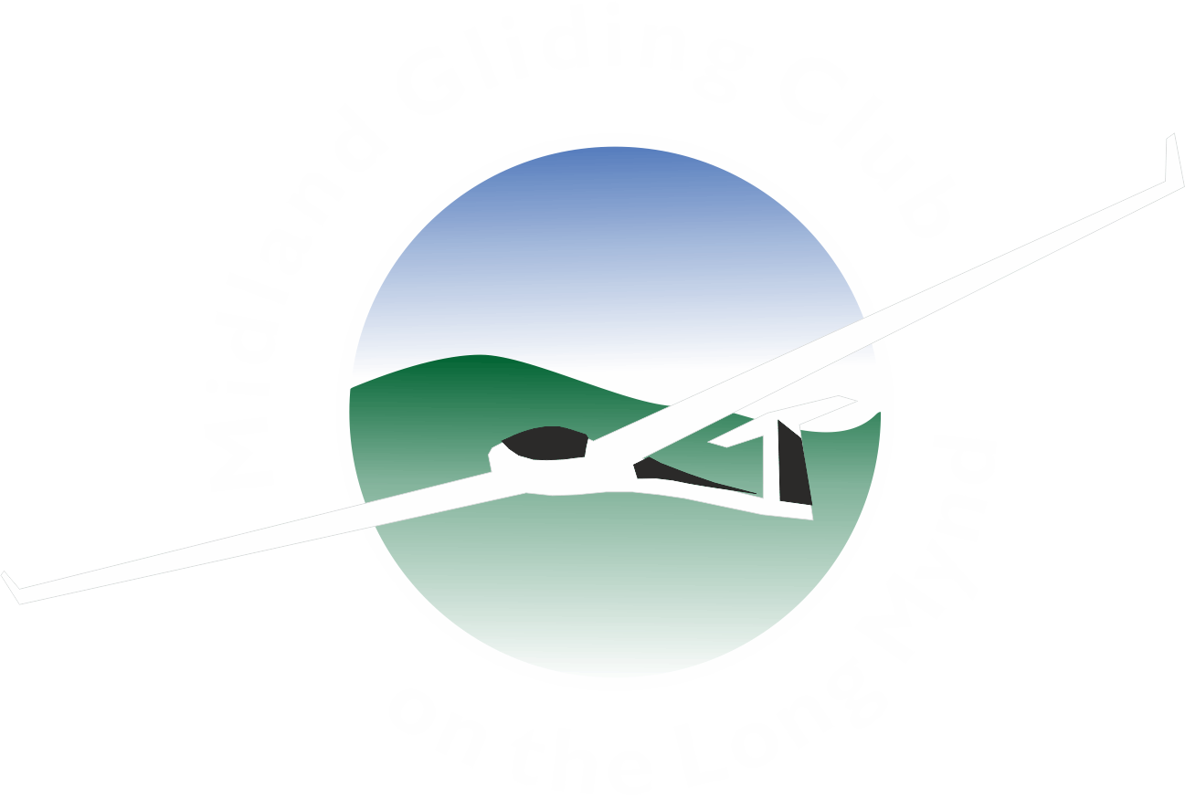
XC from the Mynd
The problems and benefits of flying away from (and back to) an airfield at 1400ft
Discussion based around 100K to 300K tasks
Presenter: Julian Fack

Slide 2
Fewer XCs than some other clubs
Reasons Mynd can be intimidating to leave:
It is often surrounded by sink
It is not very visible returning from S, N, or E
Getting home low is not clever
Cloudbase can appear low on QFE setting

Slide 3
Local positives
The Mynd is a good thermal generator
The ridge often helps to start
You are 1400ft higher
You can sometimes use the ridge to get back
Thermal soaring can continue until quite late in the day
Several private Duos and Arcus’ available for XC coaching at MGC

Slide 4
Local negatives
You must fly on (or change to) QNH
Thermal soaring starts later in the day
The Mynd can “starve” local thermals
We do not have aerotow
Launching often stops for lunch
You need 1400ft extra to get back home

Slide 5
Preparation
You must have a plan before takeoff
Set yourself an achievable task
Create milestones
Add a fallback
Watch other gliders carefully from the ground
Do not takeoff too early

Slide 6
Launch line
Have a plan where to find a climb
Watch other gliders in the air
Think about local hot spots you have used
Pull off line if you are not happy with the sky

Slide 7
First climb
If you climb well stay with it to cloudbase
Remain aware of the direction of your first leg
Start immediately if you are satisfied
Do not hang about local soaring, get going!

Slide 8
Flying the task
Be aware of the time and monitor your progress
It helps to have a visible landmark to first turn
Press on but monitor for changing conditions
Aim to lose 1000ft (or more) to next thermal
Set a “hard deck” (1/2 way to the ground)
Use your fallback if you need it
Turn back if you need to
Preserve your (personal) energy
Remember the final glide at the end of the day

Slide 9
Final glide
Ensure you understand what your kit is saying
Be aware of it’s wind calculations
Practice using it regularly, even in local soaring
Be aware of any (or no) “safety altitude” set
As a check use 10Km (5Nm) per 1000ft (30:1)
Do not attempt marginal glides to the Mynd
Beware of “getback-itis”

Slide 10
Finishing
Call on radio at least 5 mins before arrival
Call again at 1 minute
Call again on joining
Be super aware of launch and landing traffic
Remember we have a huge airfield

