Slide 1
How put your flight on the BGA and Club Ladder
Jon Hall

Slide 2
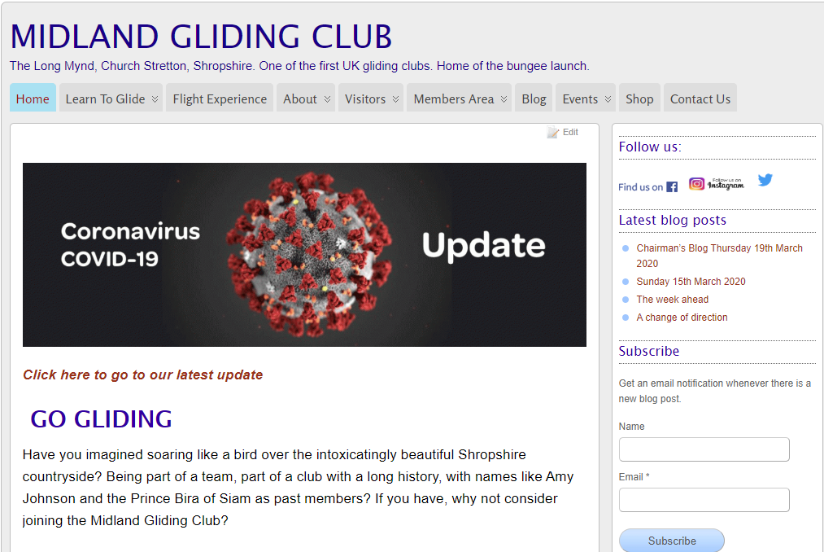
How put your flight on the BGA and Club Ladder
Open a browser and go to the club website
Click on MEMBERS AREA and then select
MGC CLUB LADDER
This will take you to the entry page on the BGA Ladder which is specifically for our club

Slide 3
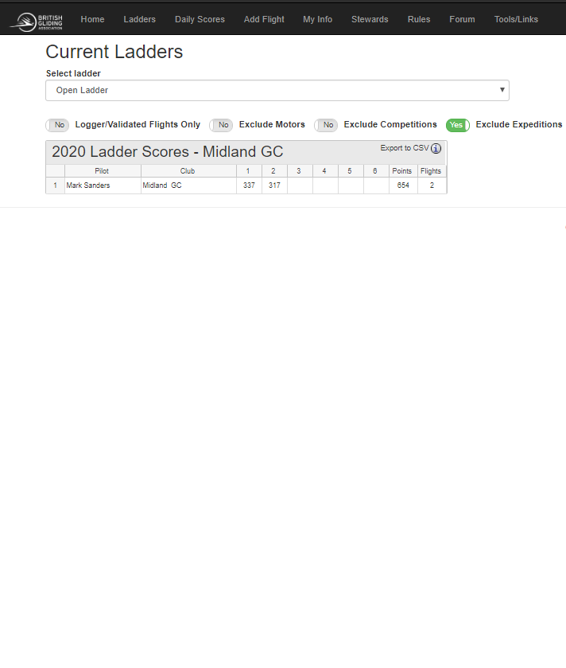
How put your flight on the BGA and Club Ladder
This opens the CURRENT LADDER results page where you can see who has done what
In the black header at the top click ADD FLIGHT which takes you to the next page

Slide 4
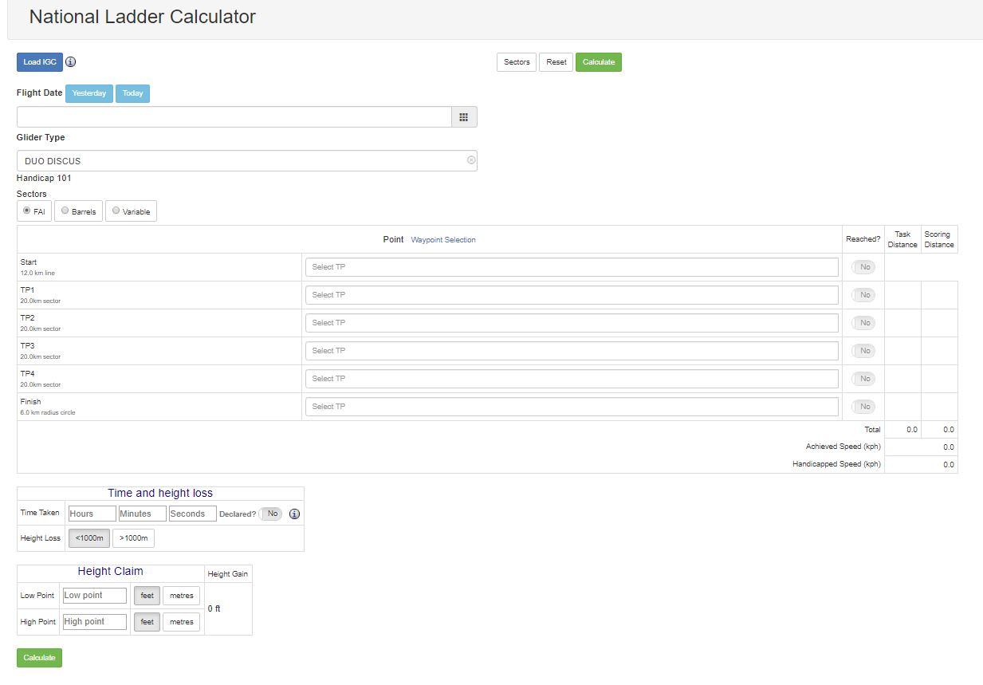
How put your flight on the BGA and Club Ladder
It may ask you to LOG IN first
If you don’t have an account create one
If you click REMEMBER ME you won’t have to Log In again
On this page enter the details of your flight
All the information you need will come from your Nav Device track file and the IGC file that you will have saved after the flight
You MUST have a valid IGC file

Slide 5
How put your flight on the BGA and Club Ladder
Don’t forget to select if you are using FAI sectors, barrels, or both
As you start to type the waypoint name you get a drop down selection list
Always click the correct REACHED box on the right (yes or no) and include MYN as start and finish waypoints
Don’t forget to click the HEIGHT LOSS box (bottom left) which should be less <1000m
When you have entered all the required data click CALCULATE (green box bottom left)

Slide 6
How put your flight on the BGA and Club Ladder
Don’t forget to select if you are using FAI sectors, barrels, or both
As you start to type the waypoint name you get a drop down selection list
Always click the correct REACHED box on the right (yes or no) and include MYN as start and finish waypoints
Don’t forget to click the HEIGHT LOSS box (bottom left) which should be less <1000m
When you have entered all the required data click CALCULATE (green box bottom left)

Slide 7
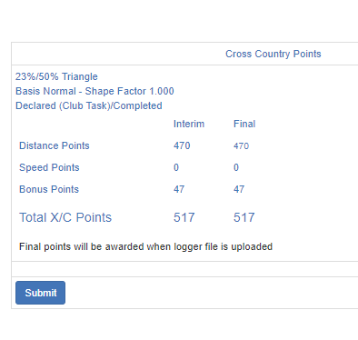
How put your flight on the BGA and Club Ladder
After clicking CALCULATE a box appears on the right with details of the cross country points your flight has accrued
Click SUBMIT

Slide 8
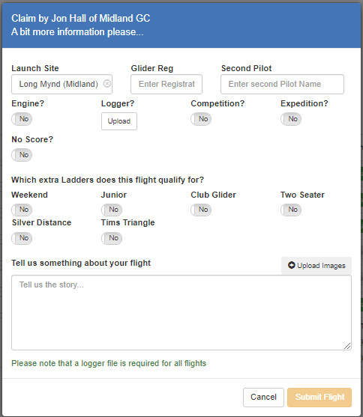
How put your flight on the BGA and Club Ladder
This opens a box asking for details of the flight
Click all the boxes that apply and UPLOAD a logger file
If your glider has an engine your logger must be capable of recording engine noise/starts

Slide 9
How put your flight on the BGA and Club Ladder
Confirm you have checked the logger file for airspace infringements
DO NOT LOG A FILE that you suspect has an airspace infringement

Slide 10
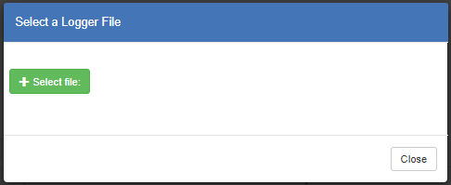
How put your flight on the BGA and Club Ladder
This next box asks you to select a file from wherever you have saved it on your computer

Slide 11
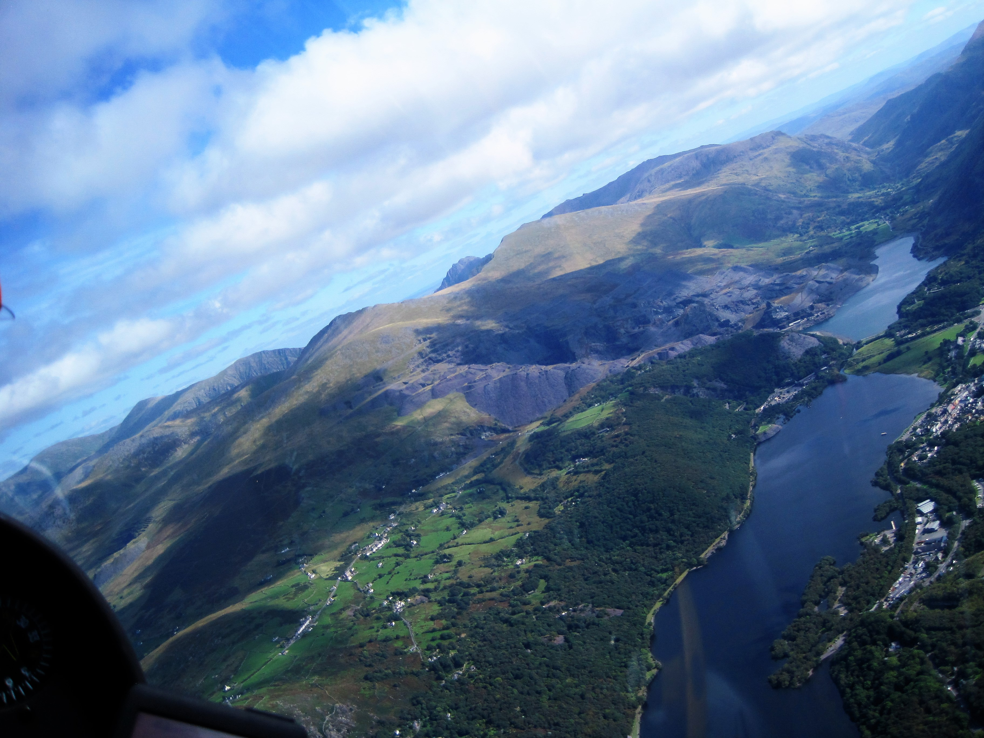
How put your flight on the BGA and Club Ladder
When you finish entering all the required details your flight will be uploaded, the IGC file checked, scored and entered on the ladder
It is always best to upload your flight the same day or the day after

