Slide 1
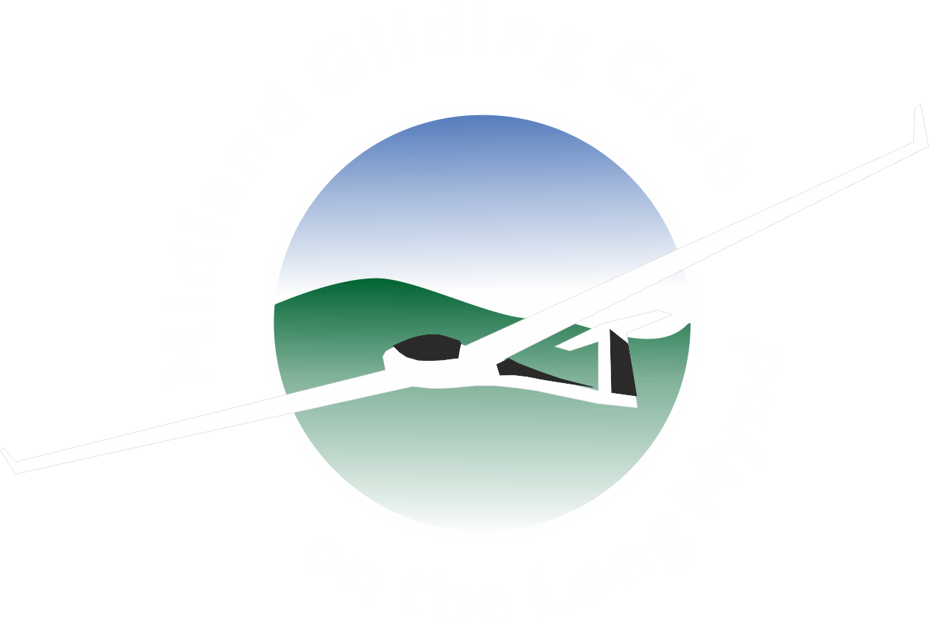
Long Mynd Glideouts and Micro Tasks
Developing the confidence to leave
Structured tasks gradually increasing
Going over the same area each time
Easy escape if needed
Return towards the ridge

Slide 2
Anecdote
Early glide out to BCS & return
with Pete Orch in K21 was my “spark”

Slide 3
Glider performance
Important to understand your glider
L/D is as useless as 0 to 60 in cars
BGA handicaps used to even up competition
Examples: K8 – 69, K6E – 81, K21 & 23 – 85
More: LS4 – 96, Duo 101, LS6 & LS8 18 – 106
High performance: Arcus 107, JS1C 21M – 118
For ease of calculation use 10K/1000ft
Lower performance ships can use 8K/1000ft

Slide 4
Choose the weather
Go for an easy first climb
Light winds from N to S through W
Cloudbase not less than 4200ft QNH (2800 QFE)
Note: BCS is Bishops Castle and CNN is Corndon
Note: MON is Montgomery and WNE is Welshpool
Note 2: Good local fields in the valley if needed

Slide 5
‘Local’ tasks
Not really XC but good for improving confidence
You will be within final glide of MYN at all times
If it goes wrong the fields you know are reachable
Short duration so can be repeated many times
You will not get tired

Slide 6
Using the electronics
Do not set a “safety altitude”
Select direct to MYN before takeoff
Have a plan, eg. start with BCS o/r, only 16.8k
At 30:1 that should use 1700ft (2000 ft) out and return
Out and return means wind is hardly a factor

Slide 7
Flying the task
Head off at top of first thermal
Eye up and remember fields on the run
Follow the energy
Only stop for big thermals, not little bubbles
Turn back if arrival altitude gets down to 2400
If you have the height turn at BCS properly
Keep a v. good lookout on approach to MYN

Slide 8
What next?
Climb away again above Mynd if you can
Using same technique return to BCS
Find a climb in the valley before or after BCS
If you fail glide back to MYN, if you succeed:
Head for CNN monitoring MYN arrival altitude.
Turn back when your arrival alt gets to 2400ft
MYN-BCS-CNN-MYN is 28.3K

Slide 9
Slightly longer tasks
An alternative is MYN-BCS-MYN-CNN-MYN
Use the Mynd to top up between legs
If c/base is above 4600 then CNN o/r is a glide
Task is almost 40K using only Mynd thermals!
You are always local to the Mynd, so not proper XC

Slide 10
Proper little XC tasks
MYN – MON – MYN, 37.5K
You need just one thermal en route, if not:
You can get back to the ridge if it’s working
If not you know all the fields in the valley

Slide 11
A bit further
MYN – WNE – MYN, 46.5K
Maybe two thermals en route
Easy glide back to our valley
Turn back at BCS or CNN if unhappy
Use the ridge if its working
Good fields near Marton Pool
All these small tasks in one flight equals 139K!

