Slide 1
How to set your POLAR
Using SeeYou Mobile on an OUDIE
Jon Hall

Slide 2
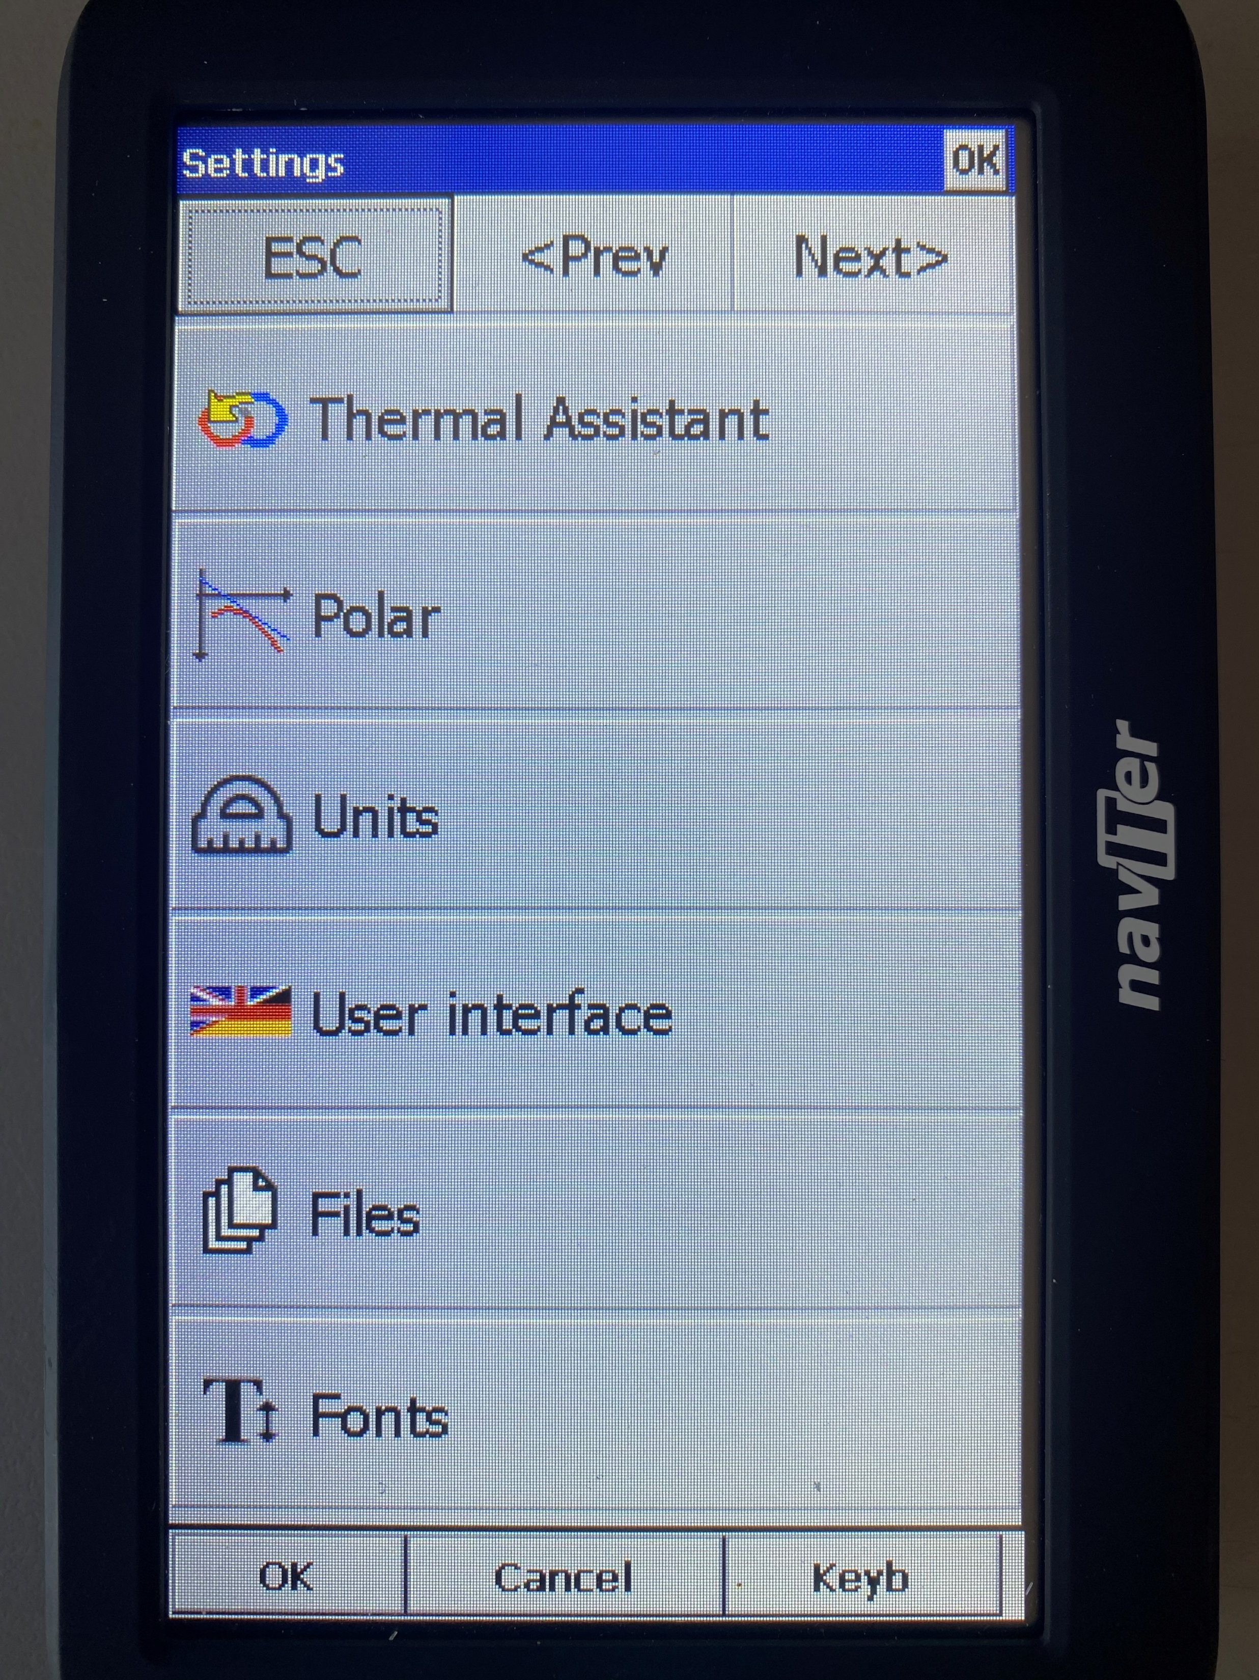
HOW TO SET UP YOUR POLAR
To get the best out of your device, especially the final glide computer bit, you need the correct polar
Go to SETTINGS
Click POLAR tab

Slide 3
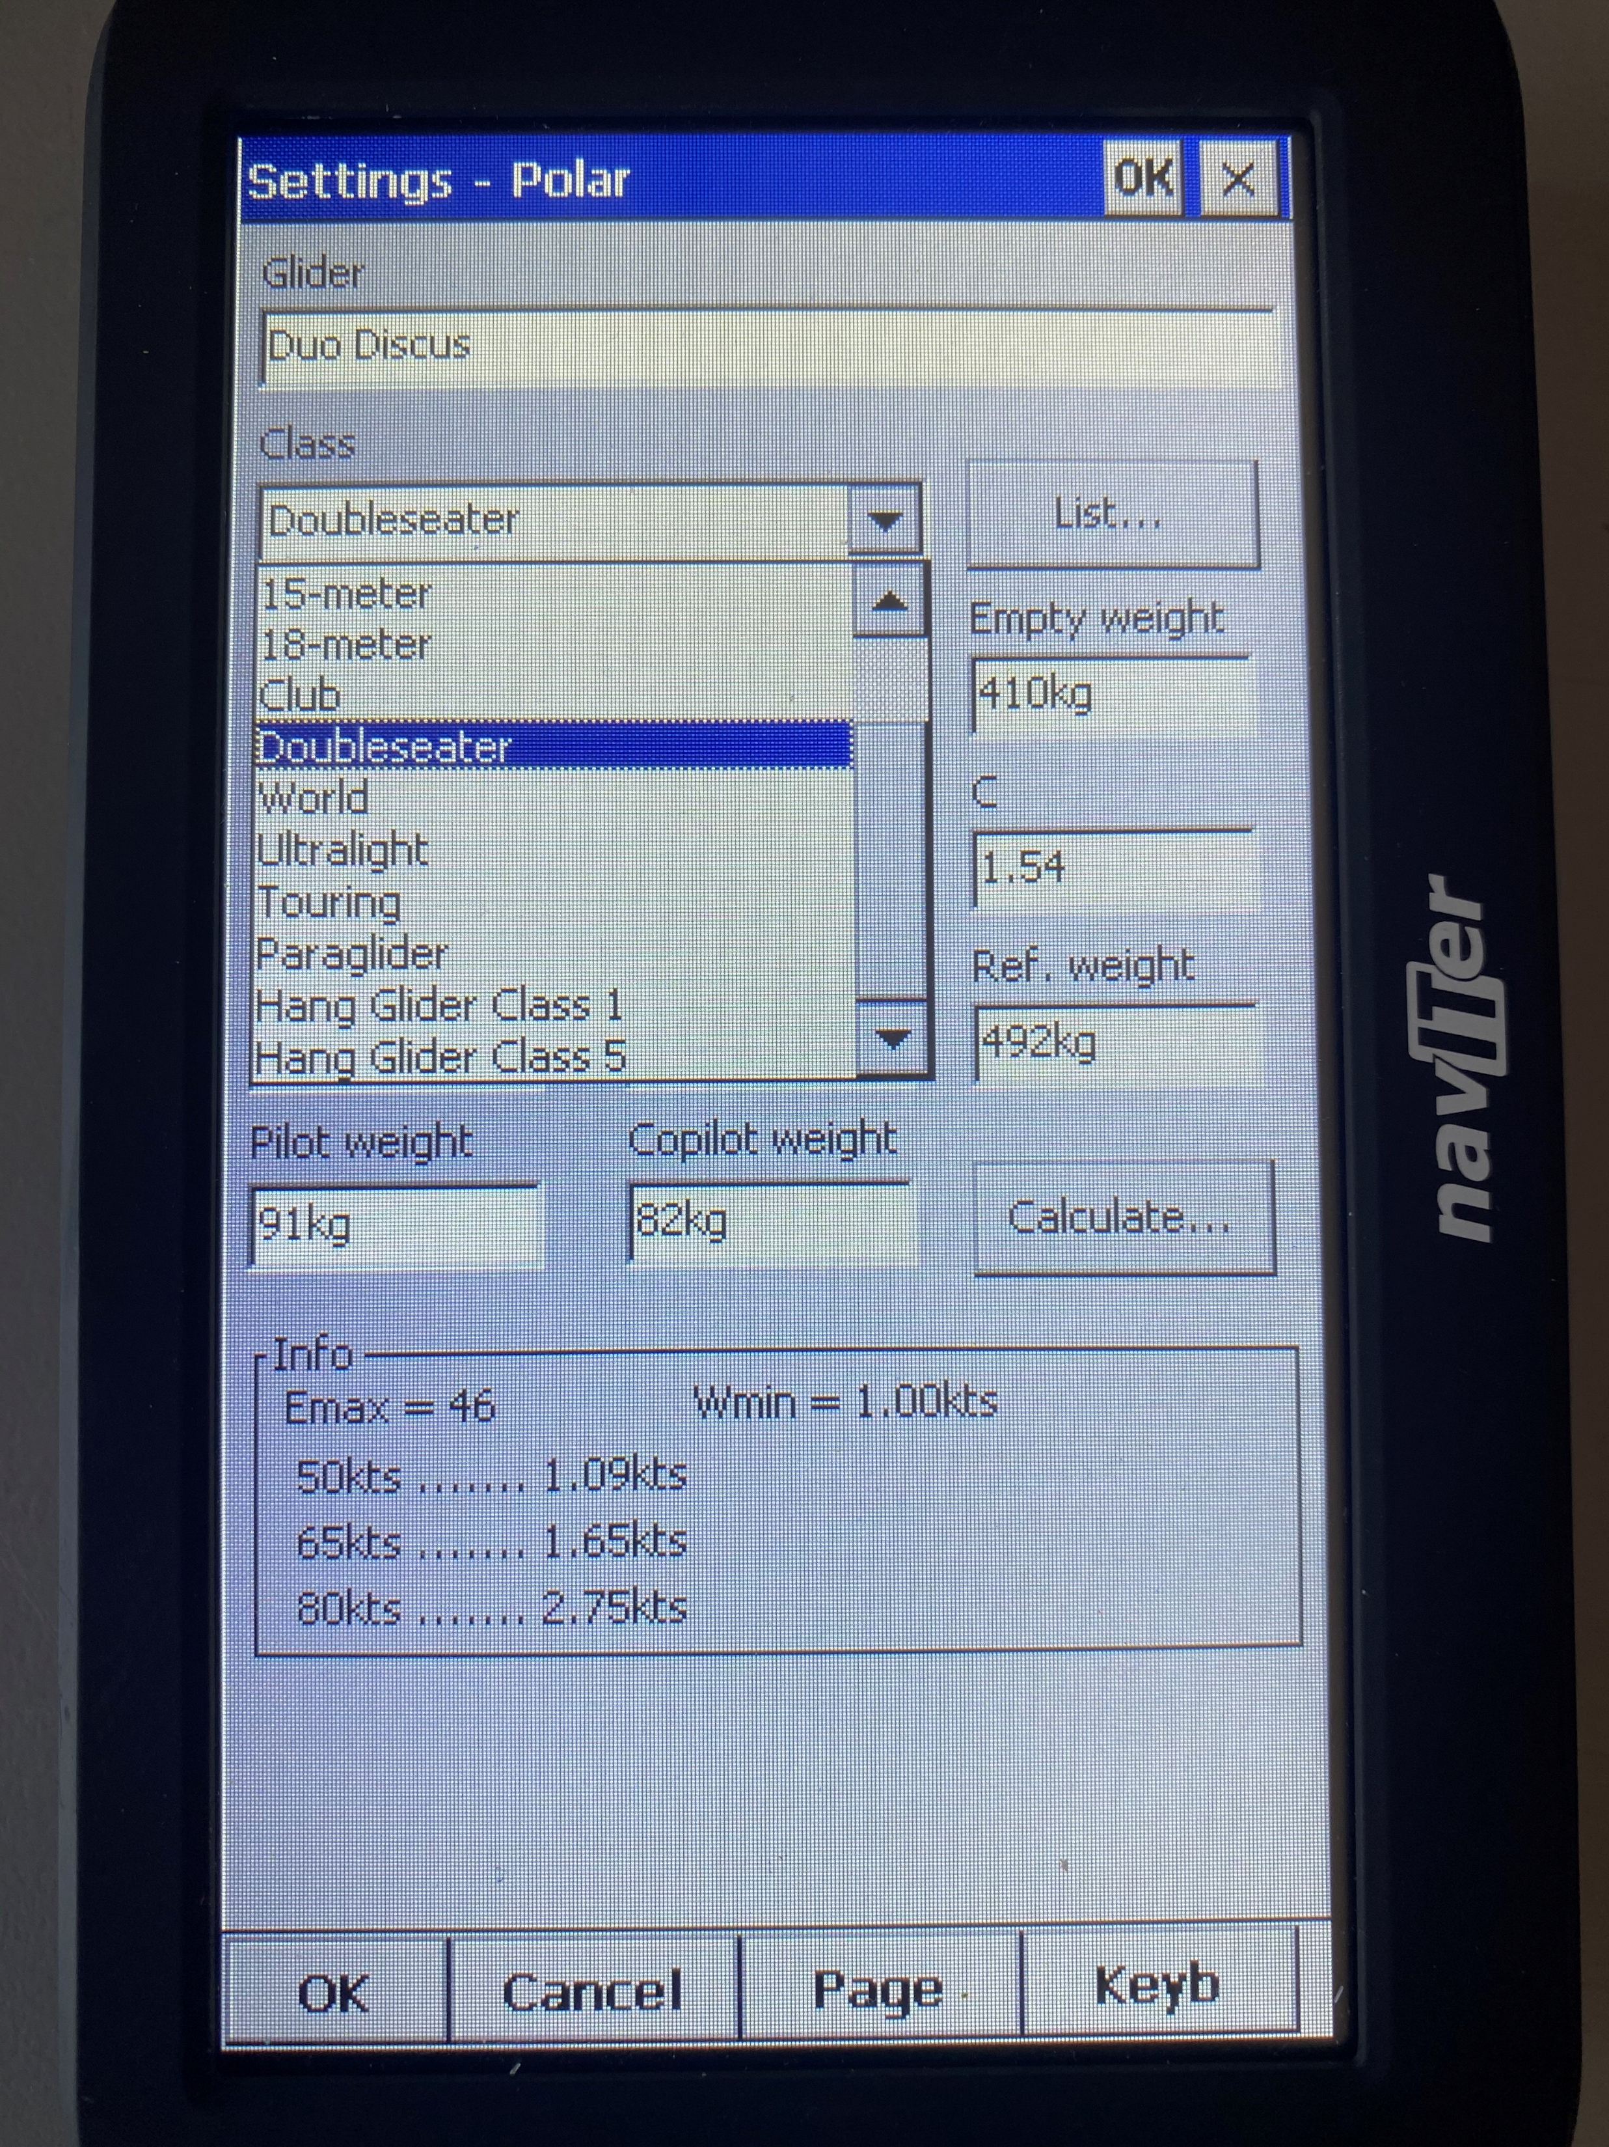
HOW TO SET UP YOUR POLAR
Click on the arrow button
Then select the class of your glider

Slide 4
HOW TO SET UP YOUR POLAR
Then click LIST button

Slide 5
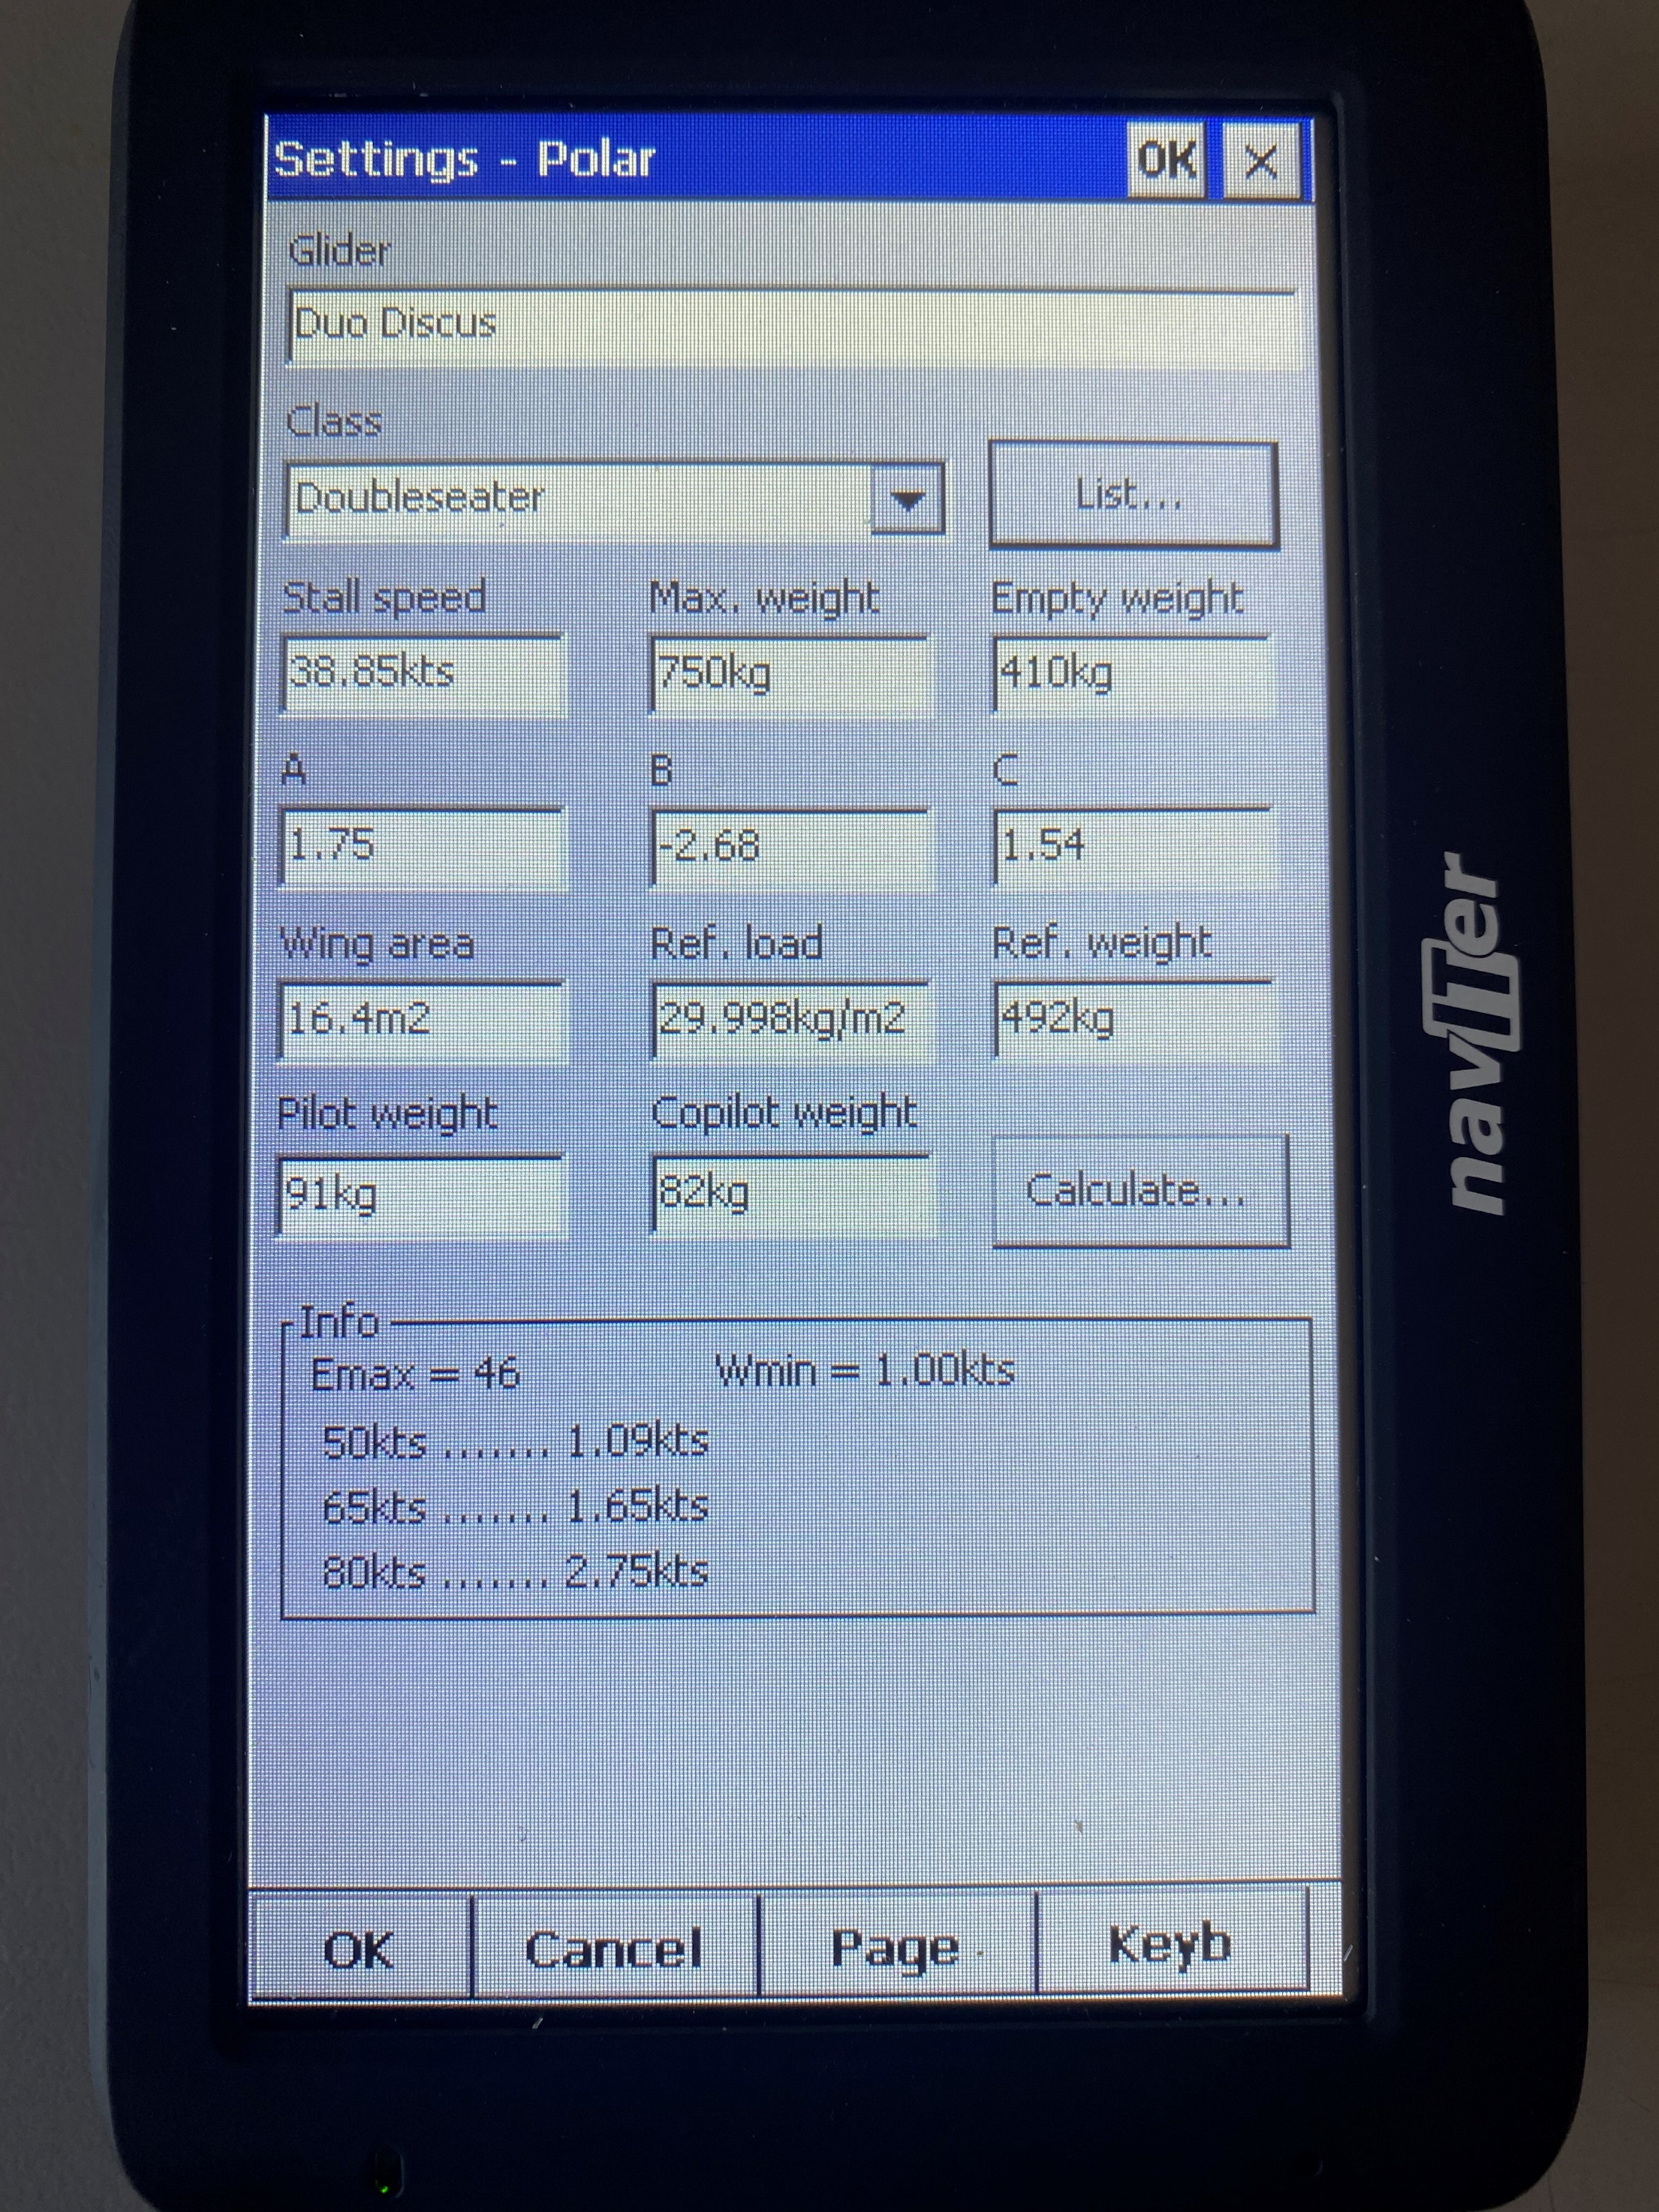
HOW TO SET UP YOUR POLAR
If your glider is in the list, most are, it will automatically populate the form with the correct details
You need to add PILOT WEIGHT
(including clothes and parachute)
The INFO box shows the sink rate at three different speeds

Slide 6
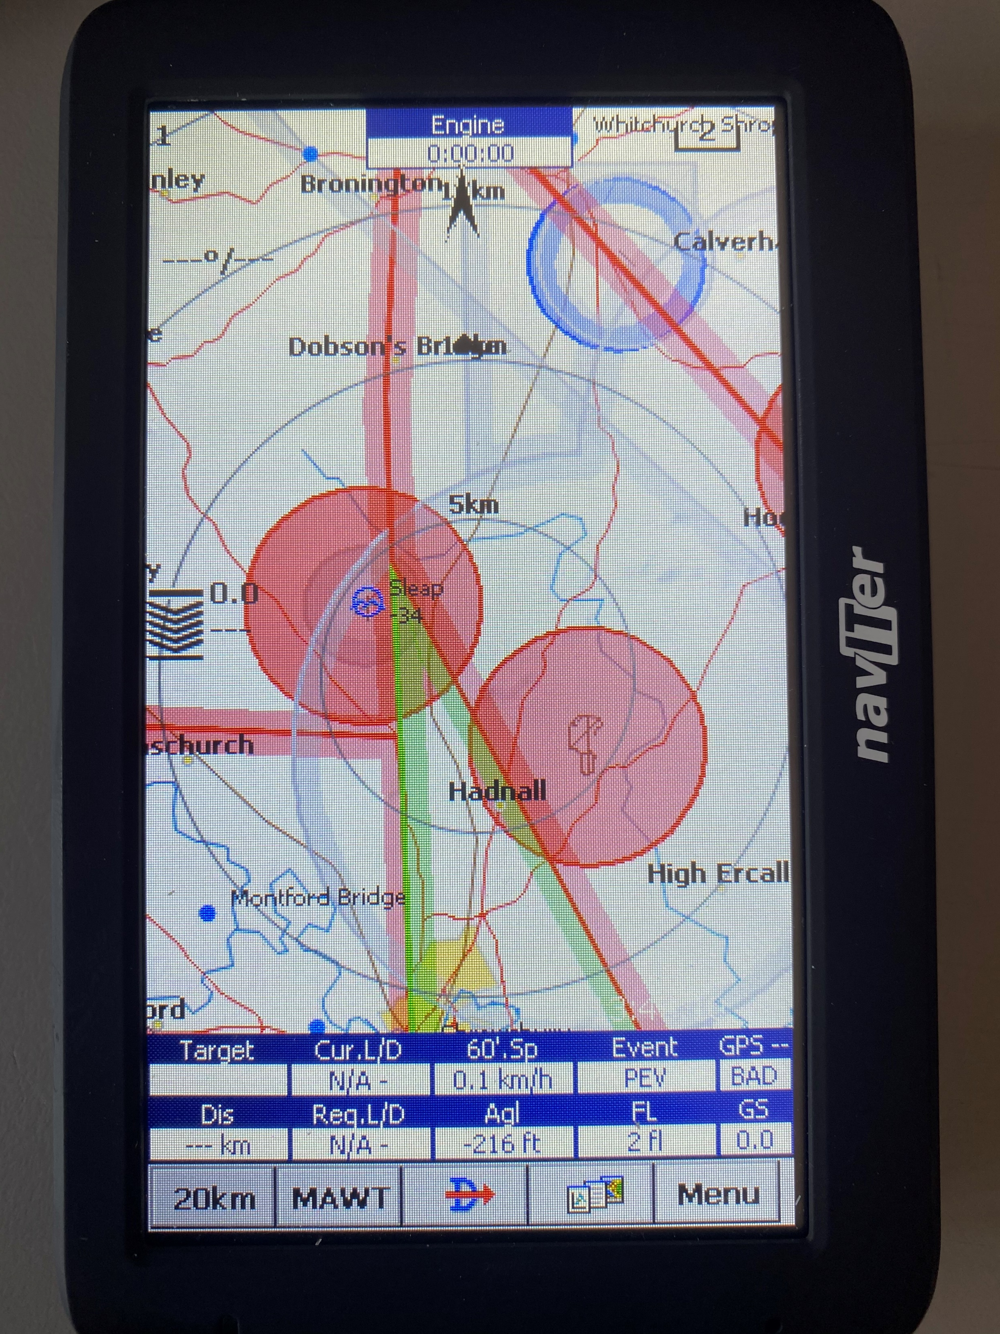
MCREADY SETTING
The correct POLAR allows your computer to calculate your final glide but only if you have the correct McCready set
McCready theory requires you set it for the strength of your last thermal, assuming conditions ahead will remain the same (and there is no terrain in the way)
For final glide it is always a bit of a guess at what you expect the conditions to be like so expect to adjust as you go

Slide 7
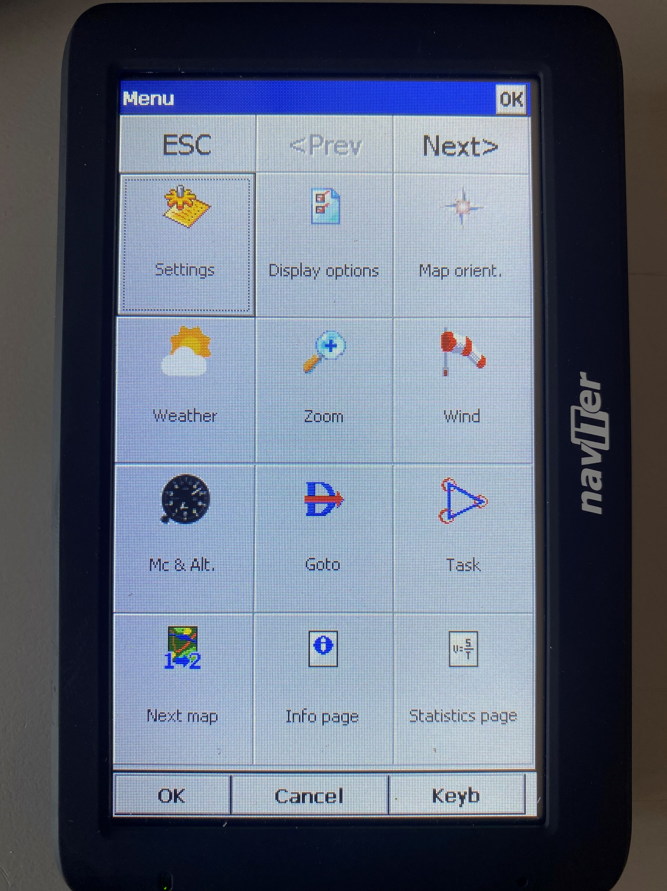
MCREADY SETTING
To change the setting click this button

Slide 8
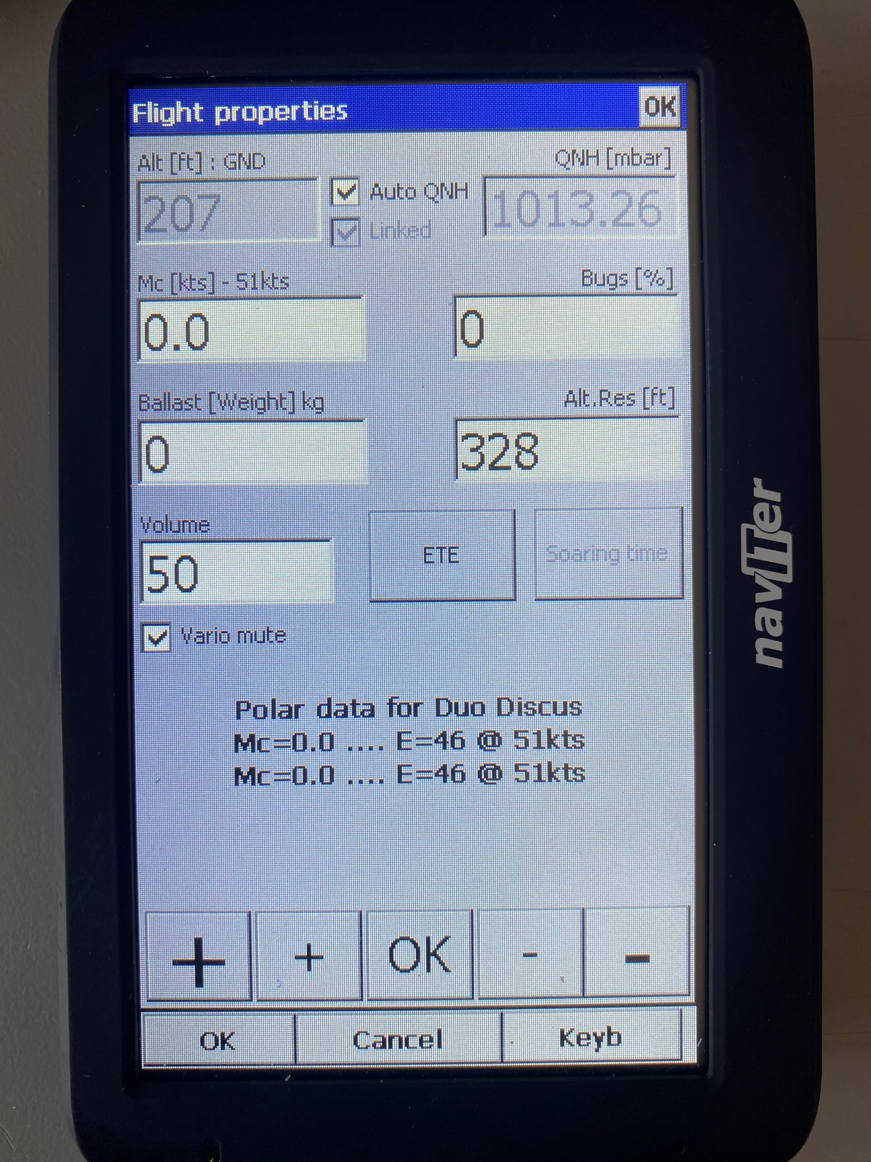
MCREADY SETTING
Which takes you to the FLIGHT PROPERTIES page
Adjust the MCReady settings at the bottom
You may want to assign actions to a couple of your NavBoxes to allow you to quickly adjust McCready up and down.
(See lecture notes on ‘How to set up SeeYou Mobile on an Oudie’)
If your OUDIE is linked to your on board instruments any adjustment of the McCready there will be reflected in the OUDIE

Slide 9
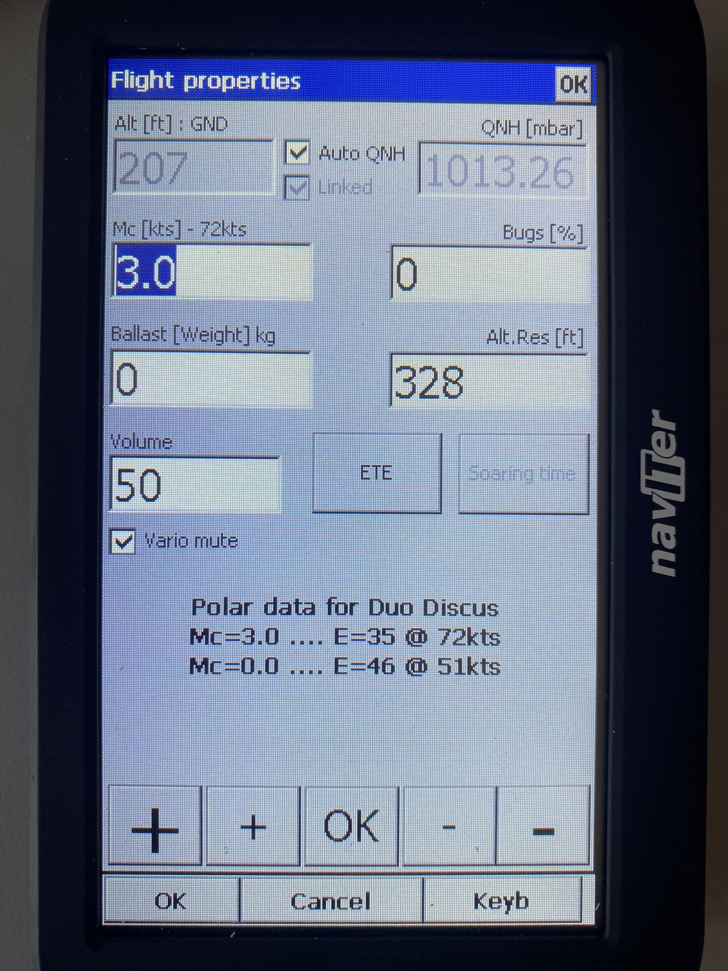
MCREADY SETTING
If you increase or decrease the POLAR it shows expected L/D at Mc 3.0 and Mc 0.0 at the bottom

