Slide 1
Midland Gliding Club
Rules of the Air
& Good Airmanship
April 2021
Notes:
There are two versions of this presentation …
Click Custom Slide Show
“Full Presentation” - 17 Slides. More wordy. Better for more established pilots
“Pre-Solo Show” – 10 Slides. Concentrated on the essentials. The one to use for First / Early Solo pilots

Slide 2
Agenda
Basic Rules concerning collision avoidance
Rules for Thermalling
Rules for Ridge Soaring
Airmanship (TEM)

Slide 3
Here’s what SERA has to say …
SERA – Standardised European Rules of the Air
Proximity
An aircraft shall not be operated in such proximity to other aircraft as to create a collision hazard.
Right-of-way
The aircraft that has the right-of-way shall maintain its heading and speed. An aircraft that is obliged by the following rules to keep out of the way of another shall avoid passing over, under or in front of the other, unless it passes well clear and takes into account the effect of aircraft wake turbulence.
Notes:
Right of way… Common sense required.
“It might not be your fault, but it will always be your problem”
ANO Used to say “All pilots must take all necessary steps to avoid a collision”

Slide 4
Approaching head-on
When two aircraft are approaching head-on or approximately so and there is danger of collision…
each shall alter its heading to the right.
Notes:
Good airmanship means picking this up early and making a small course correction sooner, with plenty of time to lookout and check that your manoeuvre will not create more problems than it solves
May need to be pull or push if you pick them up late. 50/50 chance you will both go the same way.

Slide 5
Converging
When two aircraft are converging at approximately the same level…
the aircraft that has the other on its right shall give way (“Right has Might”)
Notes:
Good airmanship means picking it up early and deciding which way to go.
Steering to the rear of the converging aircraft keeps it fully in view at all time, but may not be appropriate if you pick it up late or it is a very shallow convergence.

Slide 6
Converging - except as follows
power-driven heavier-than-air aircraft shall give way to airships, sailplanes and balloons;
airships shall give way to sailplanes and balloons;
sailplanes shall give way to balloons;
power-driven aircraft shall give way to aircraft which are seen to be towing other aircraft or objects.

Slide 7
Overtaking
An aircraft that is being overtaken has the right-of-way and the overtaking aircraft, whether climbing, descending or in horizontal flight, shall keep out of the way of the other aircraft by altering its heading to the right, and no subsequent change in the relative positions of the two aircraft shall absolve the overtaking aircraft from this obligation until it is entirely past and clear.
Sailplanes overtaking
A sailplane overtaking another sailplane may alter its course to the right or to the left (please note that this is a SERA rule and may not apply outside Europe).
Notes:
Remember, until you can see his face, he can’t see you.

Slide 8
Overtaking
An aircraft that is being overtaken has the right-of-way and the overtaking aircraft shall keep out of the way of the other aircraft by altering its heading to the right
A sailplane overtaking another sailplane may alter its course to the right or to the left

Slide 9
Landing
An aircraft in flight, or operating on the ground or water, shall give way to aircraft landing or in the final stages of an approach to land. When two or more heavier-than-air aircraft are approaching an aerodrome or an operating site for the purpose of landing, aircraft at the higher level shall give way to aircraft at the lower level, but the latter shall not take advantage of this rule to cut in front of another which is in the final stages of an approach to land, or to overtake that aircraft. Nevertheless, power-driven heavier-than-air aircraft shall give way to sailplanes.
Emergency landing
An aircraft that is aware that another is compelled to land shall give way to that aircraft.
Notes:
Airmanship means seeing the landing area is likely to be congested and considering early an option to land elsewhere on the airfield

Slide 10
Joining a Thermal
Gliders already established in a thermal have the right of way.
All pilots shall circle in the same direction as any glider(s) already established in lift.
If there are gliders thermalling in opposite directions, the joining gliders shall turn in the same direction as the nearest glider (least vertical separation). (Best pick another thermal at beginner level!)
The entry to the turn should be planned to retain continual visual contact with all other aircraft at or near the planned entry height, and to ensure no glider already turning will be required to manoeuvre to avoid the joining glider.
If possible, join the same circular track as the other glider, or if that is not practical, join a circle wider than that of the thermalling glider and only move onto that glider’s circle when you can achieve safe separation.

Slide 11
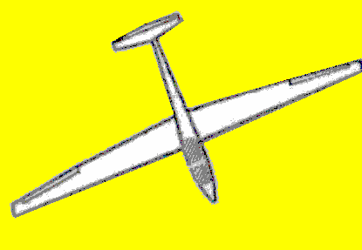
Joining a Thermal
🎪
Pick out the position of the circling glider against the horizon as they are heading directly away from you.
If you are sure that there will be adequate separation when you arrive, fly directly to that point on the horizon (A)
If you are not sure there will be separation, then fly to a point outside of the circle (B) and gradually work your way in, as and when you have safe separation
A
B

Slide 12
Staying in a Thermal
Lookout is always paramount. Never allow your monitoring of in-cockpit equipment to interfere with your lookout. Maintain visual contact with established gliders and position your glider so established pilots can see your glider.
When at a similar level to another glider, never turn inside or point your glider at or ahead of the other glider unless you can guarantee safe separation and maintain visual contact.
If you lose visual contact with a nearby glider or if you cannot guarantee safe separation or feel uncomfortable, leave the thermal.
Look out for other aircraft joining or converging in height.
Look outside the turn and behind before straightening up. Do not manoeuvre sharply unless clear of all other aircraft.

Slide 13
Sharing a Thermal
Try to maintain a position where you can see the other gliders and be seen by them
Increase your angle of bank to catch up
Decrease your angle of bank to fall back
Remember… It’s a big old sky – if you feel uncomfortable, exit with due caution and find another thermal

Slide 14
Ridge Soaring
Make all turns away from the ridge.
Where reasonably possible, remain 500′ clear of people and property.
NEVER fly close to, towards or directly over any person on the ground.
Do not fly lower than necessary to utilise the soaring conditions
Lookout is always paramount.
Remain clear of other aircraft. The glider with the ridge on the right has priority.
Overtake with extreme caution, bearing in mind the other glider could suddenly change direction. A full 360 degree orbit with appropriate lookout or turning back early may be a safer option than overtaking.
Be aware that when flying with a significant drift angle, FLARM direction indications can be misleading.
Always have an available safe landing option.

Slide 15
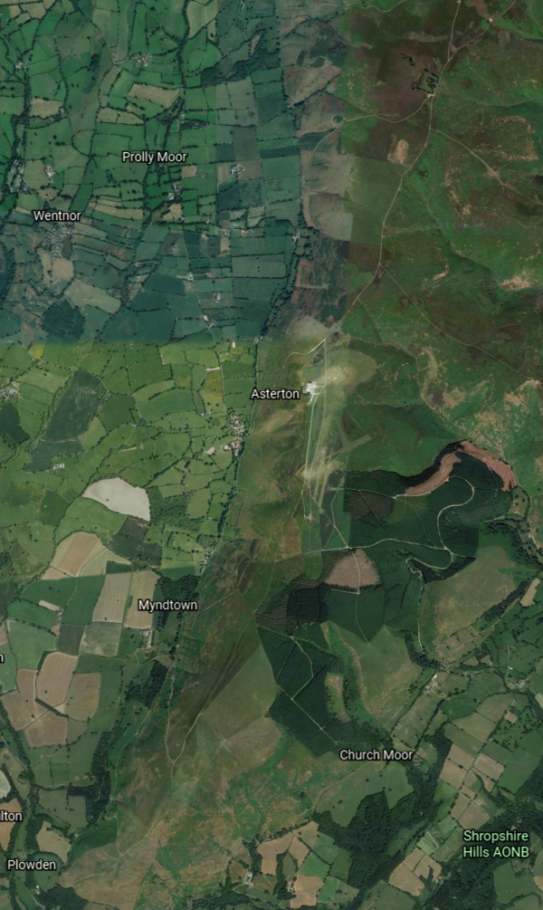
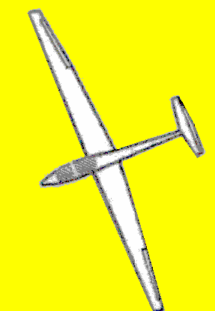
The Mynd Ridge
A
Hazards
Modeller’s Bowl at Pole Cottage (A)
HG/PG Field (B)
HG and particularly PG traffic can be very dense, and there is a huge speed differential.
Other Gliders!!!
Low Sun – visual contact may only be one way!
Take early, but cautious, avoiding action. A good lookout and a clear plan is needed, so that in avoiding one hazard you don’t inadvertently steer into the path of another!
B
Notes:
Models will fly in any wind speed 5-50 kts!
Turn back early if there are models flying …
A “glider” a long way off may turn out to be a scale model much, much closer!
PG 8-15kts HG 10-20kts
HG/PG cover much more ground downwind than upwind
Airmanship…
If you take early avoiding action, only a few degrees course change may be needed it and the other aircraft seeing your course change will have an indication he has been spotted.
Late action requires a much greater course change with possible impacts on other aircraft.

Slide 16
Airmanship / TEM
TEM – Threat and Error Management
Threat: Something external to you that may cause you a problem
Error: A problem that you might cause by an action or omission
Engaging your Gliding Brain
Staying alert and ahead of the game
Seeing the Bigger Picture for yourself and those around you
Exploring and expanding your own personal envelope, but recognising when you are reaching your personal limits for the flight
It’s something you will pick up by osmosis through exposure and experience
Notes:
Flying equivalent of “Road Craft”

Slide 17
Any Questions …

