Slide 1
Stall & Spin Training in Gliders

Slide 2
Stall & Spin Training in Gliders
What is the intention?
recognise the symptoms of an approaching stall and take timely avoiding action
become familiar with the characteristics of the full stall
learn how to recover with minimum loss of height
avoid inadvertent stalling & spinning by developing safe flying habits in all phases of flight
Stalling & spinning sounds dramatic but it is well understood
Exercises are conducted at height with lots of recovery margin – training is perfectly safe
Training exercises are gradual and are demonstrated over multiple flight sorties
Notes:
What is the intention?
recognise the symptoms of an approaching stall and take timely avoiding action
become familiar with the characteristics of the full stall
learn how to recover with minimum loss of height
avoid inadvertent stalling & spinning by developing safe flying habits in all phases of flight
Stalling & spinning sounds dramatic but it is well understood
Exercises are conducted at height with lots of recovery margin – training is perfectly safe
Training exercises are gradual and are demonstrated over multiple flight sorties

Slide 3
Stall & Spin Training in Gliders
Step 1: Slow flight & recognition of the approaching stall
Step 2: Basic stalls & recovery
Straight stall
Wing drop stall
Mush stall
Step 3: Further stalls & recovery – more representative of real life scenario
Stalling speed increases in a turn
High speed stall
Low G not a reliable symptom of a stall
Step 4: Basic spin training & recovery
Step 5: Further spin training – more representative of real life scenario
Changing effect of the rudder at or near stall
Spin off a steep or thermal turn
Spin off a failed winch launch
Step 6: Spiral dive training & recovery
Notes:
Not going to cover the further exercises in this talk – you should be briefed specifically for those by your instructor.
The scope of this talk is to introduce basic stalls and spins to you.
Step 1: Slow flight & recognition of the approaching stall
Step 2: Basic stalls & recovery
Straight stall
Wing drop stall
Mush stall
Step 3: Further stalls & recovery – more representative of real life scenario
Stalling speed increases in a turn
High speed stall
Low G not a reliable symptom of a stall
Step 4: Basic spin training & recovery
Step 5: Further spin training – more representative of real life scenario
Changing effect of the rudder at or near stall
Spin off a steep or thermal turn
Spin off a failed winch launch
Step 6: Spiral dive training & recovery

Slide 4
Stall & Spin Training in Gliders
Initial Stalls
What is a stall?
In straight and level flight the Weight of an aircraft is balanced by the Lift generated by the wings. A cruising glider isn’t in true level flight but actually a gradual descending glide profile.
Insert weight balance L/D diagram
Insert wing diagram with attached airflow
.
Notes:
In straight and level flight the Weight of an aircraft is balanced by the Lift generated by the wings. A cruising glider isn’t in true level flight but actually a gradual descending glide profile.
Stalls depend only on angle of attack, not airspeed. However, the slower an aircraft flies, the greater the angle of attack it needs to produce lift equal to the aircraft's weight. As the speed decreases further, at some point this angle will be equal to the critical (stall) angle of attack. This speed is called the "stall speed".

Slide 5
Stall & Spin Training in Gliders
The total Lift generated by a wing is dependent on a number of factors and most are outside the pilot’s control e.g.
Air density
Wing area
Wing shape (planform)
Wing shape (camber – although some gliders have camber changing flaps)
The factors affecting the Lift that are in a pilot’s direct control are:
Airspeed
Angle of Attack
Angle of Attack is what we are interested in regarding stalls & spins.
.
Notes:
The total Lift generated by a wing is dependent on a number of factors and most are outside the pilot’s control e.g.
Air density
Wing area
Wing shape (planform)
Wing shape (camber – although some gliders have camber changing flaps)
The factors affecting the Lift that are in a pilot’s direct control are:
Airspeed
Angle of Attack
Angle of Attack is what we are interested in regarding stalls & spins.

Slide 6
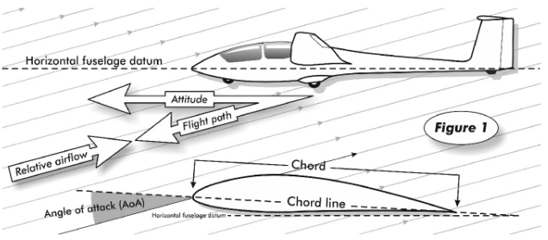
Stall & Spin Training in Gliders
Angle of Attack is the angle at which the wing aerofoil meets the oncoming airstream.
Changing the pitch of the glider is one way to change the angle of attack.
.
Notes:
Angle of Attack is the angle at which the wing aerofoil meets the oncoming airstream.
Changing the pitch of the glider is one way to change the angle of attack.

Slide 7
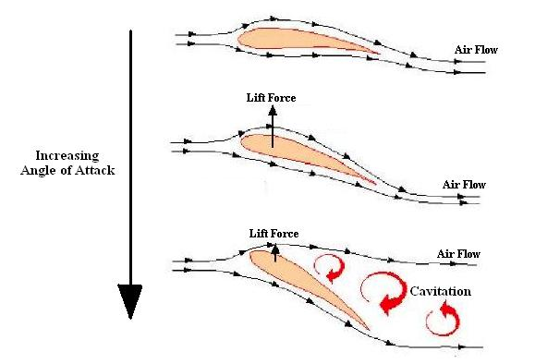
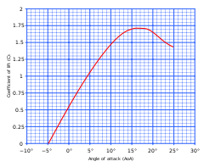
Stall & Spin Training in Gliders
In unaccelerated flight the Lift produced by the wings always has to equal the Weight of the glider.
Lift generation is reliant on a smooth flow of air over the surface of the wing.
Airspeed is one factor that generates lift. Angle of Attack is another.
The slower an aircraft flies, the greater the angle of attack it needs to produce lift equal to the aircraft's weight. As the speed decreases further, at some point this angle will be equal to the critical (stall) angle of attack. This speed is called the "stall speed".
As speed reduces, angle of attack has to increase to keep lift constant until the critical angle is reached.
Notes:
In unaccelerated flight the Lift produced by the wings always has to equal the Weight of the glider.
Lift generation is reliant on a smooth flow of air over the surface of the wing.
Airspeed is one factor that generates lift. Angle of Attack is another.
The slower an aircraft flies, the greater the angle of attack it needs to produce lift equal to the aircraft's weight. As the speed decreases further, at some point this angle will be equal to the critical (stall) angle of attack. This speed is called the "stall speed".
As speed reduces, angle of attack has to increase to keep lift constant until the critical angle is reached.

Slide 8
Stall & Spin Training in Gliders
Initial Stalls
What is a stall?
Stalling is the loss of Lift caused by flow separation from the wing surfaces.
Stalls depend only on angle of attack, not airspeed.
Reducing your airspeed is one way to increase the Angle of Attack.
Stalls are still possible at higher speeds in scenarios that create a higher angle of attack.
Stall recovery training = spin avoidance training!
.
Notes:
Initial Stalls
What is a stall?
Stalling is the loss of Lift caused by flow separation from the wing surfaces.
Stalls depend only on angle of attack, not airspeed.
Reducing your airspeed is one way to increase the Angle of Attack.
Stalls are still possible at higher speeds in scenarios that create a higher angle of attack.
Stall recovery training = spin avoidance training!

Slide 9
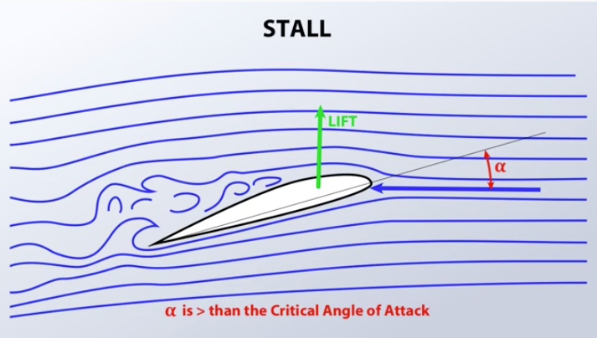
Stall & Spin Training in Gliders
Diagram 1 – aerofoil flow & separation
Notes:
This diagram is all well and good but how do you recognise a stall condition from the cockpit?

Slide 10
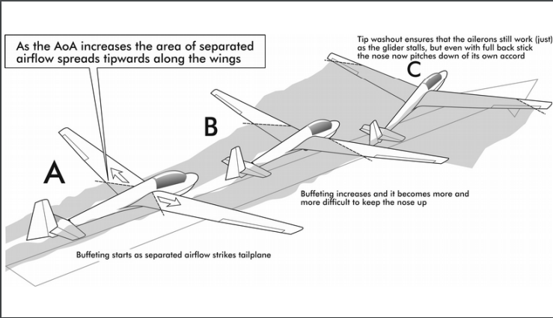
Stall & Spin Training in Gliders
https://www.youtube.com/watch?v=YVx2e1ugBsc
Notes:
Wing cross sections are all well and good to help us understand the theory but we need to put this into a 3D context so that we can understand it from the cockpit.
Regulators and aircraft manufacturers work together to help us
the onset of a stall is accompanied by clear indicators i.e. stall buffett
Control authority is retained as long as possible
CS22 requires that a stall warning may be furnished either through the inherent aerodynamic qualities of the sailplane (e.g. buffeting) or by a device that will give clearly distinguishable indications.
Our challenge as pilots is to recognise the symptoms of the approaching stall and apply corrective control inputs to avoid it
Talk through slide and then show video
Mute 0:57 through 2:16
For the trailing-edge stall, separation begins at small angles of attack near the trailing edge of the wing while the rest of the flow over the wing remains attached. As angle of attack increases, the separated regions on the top of the wing increase in size as the flow separation moves forward, and this hinders the ability of the wing to create lift.

Slide 11
Stall & Spin Training in Gliders
Initial Stalls
How to recognise a stall from the cockpit
The one symptom present in every stall is the elevator's ineffectiveness at raising the nose of the glider.
Not all of the following stall symptoms may be present, or all that obvious:
airframe buffet
the nose attitude higher than normal
the airspeed slow or reducing
changes in airflow noise
flickering ASI
changed effectiveness of elevator, ailerons and/or rudder
unusual control positions for the particular phase of flight. For example, lots of out-turn aileron
higher rate of descent
Notes:
Watch for these individual symptoms in the video
With the exception of wire launch failures, it's unlikely that a pilot will stall inadvertently with the nose held very high, simply because the attitude is so obviously abnormal. The most likely place for an inadvertent stall is close to the ground.
Initial Stalls
How to recognise a stall from the cockpit
The one symptom present in every stall is the elevator's ineffectiveness at raising the nose of the glider.
Not all of the following stall symptoms may be present, or all that obvious:
airframe buffet
the nose attitude higher than normal
the airspeed slow or reducing
changes in airflow noise
flickering ASI
changed effectiveness of elevator, ailerons and/or rudder
unusual control positions for the particular phase of flight. For example, lots of out-turn aileron
higher rate of descent

Slide 12
Stall & Spin Training in Gliders
How to recover from a stall:
Ease forwards on the stick
regain flying speed
return to the required gliding attitude (for that phase of flight)
How/why does this work?
Reduces the Angle of Attack
Reduces the G loading on the wings
Increases airspeed
Unstalls the glider
Notes:
How to recover from a stall:
Ease forwards on the stick
regain flying speed
return to the required gliding attitude (for that phase of flight)
How/why does this work?
Reduces the Angle of Attack
Reduces the G loading on the wings
Increases airspeed
Unstalls the glider

Slide 13
Stall & Spin Training in Gliders
Spins
Spinning has been around since the dawn of aviation.
Stall recovery was understood relatively early but spin recovery took several more years.
A spin is an auto rotation caused by one or both wings being stalled.
At it’s simplest, a spin is caused by a stall with yaw present
The characteristics of the spin itself are a coupling between aerodynamic & inertial forces
The spin and associated recovery incur a relatively large height loss & high rate of descent
Not a problem at altitude but definitely problematic at lower heights
Spinning characteristics and recovery techniques are driven by the aircraft design
Circa WW1, spin characteristics and recovery techniques were different for every new aircraft model
Spin recovery characteristics are now a part of aircraft certification standards
CS22 (Sailplanes) says the glider needs to recover within one complete turn.
(1.5 turns if glider not in configuration for “intentional spinning”.)
It must be impossible to obtain uncontrollable spins with any use of the controls.
The standardised spin recovery technique will work for all gliders designed to CS22 and being flown within their weight & CG limits – hence the ‘B’ for Ballast in pre-flight checks
Notes:
Many early pioneers were killed in stall and spin accidents
Prior to WW1, design configurations were being experimented with – the design factors that affected spin characteristics weren’t fully established.
Prior to WW1 the challenges of heavier than air aircraft design was still the primary goal for aircraft designers.
Stalls were understood fairly early on – the Wright flyer had an elevator in a canard configuration to guard against stalling
But the mechanism and recovery techniques for spinning took longer. And designing an aircraft with benign spin behaviour took even longer.
During WW1 for example the main design goal was for combat advantage over the enemy. All sorts of unusual design configurations were tried.
This led to an equally wide range of spin characteristics and recovery techniques. Some aircraft designs were simply impossible to recover from a spin.
As if aerial combat in WW1 wasn’t risky enough some pilots would try to demonstrate their bravery by deliberately spinning their aircraft and then trying to work out a spin recovery technique on the way down.
Aircraft design these days is much more closely regulated. Glider design in particular is regulated by Certification Standard CS22 which mandates particular spin characteristics that subsequently require a standard recovery technique.

Slide 14
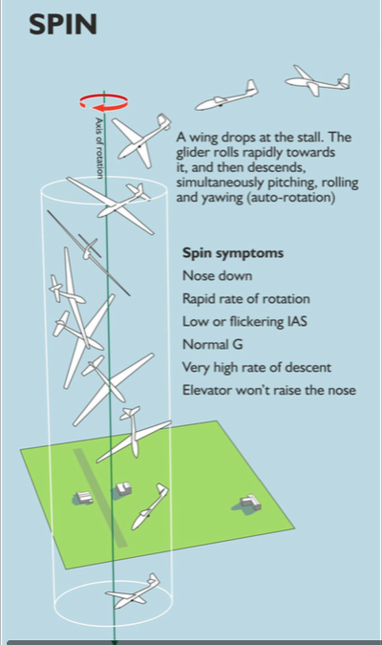
Stall & Spin Training in Gliders
Spins
https://www.youtube.com/watch?v=P-UMWk8thrw

Slide 15
Stall & Spin Training in Gliders
Spins – some factors are determined in the design office
Areas of the flying and control surfaces
Lever arm distances to the control surfaces
Mass distribution & wingspan – gliders spin less dramatically than power aircraft (swing analogy)
Wing design – washout
Why do we still train glider pilots for stalling and spinning?
Glider designs mean that stalls/spins are standardised, benign and recoverable
Eliminating stalling is not possible
Gliders will spin when stalled with yaw present
Situational awareness is a key element in avoiding stalled flight
Notes:
Stalling and spinning cannot be eliminated by aircraft design.
They can be standardised such that they are benign, predictable and recoverable.
Human factors then become the key.
Spins – some factors are determined in the design office
Areas of the flying and control surfaces
Lever arm distances to the control surfaces
Mass distribution & wingspan – gliders spin less dramatically than power aircraft (swing analogy)
Wing design – washout
Why do we still train glider pilots for stalling and spinning?
Glider designs mean that stalls/spins are standardised, benign and recoverable
Eliminating stalling is not possible
Gliders will spin when stalled with yaw present
Situational awareness is a key element in avoiding stalled flight

Slide 16
Stall & Spin Training in Gliders
Spins – the causes in the cockpit
Any circumstance leading to a stall with yaw present
Failure to recognise stall symptomsCofG position (a light pilot near the lower weight limit will find it easier to enter a spin)
High workload situations
Distraction from flying the glider.
Deterioration in speed control and stick / rudder co-ordination
Not recognising symptoms of approaching stall - not all stall symptoms may be present or obvious
Situational awareness of raised stall speed
Turning flight
Wet wings / icing
Turbulence & wind gradient
Flap deployment (alters wing bending and washout)
Opening airbrakes particularly during a turn
Engine extended
Increased G loading
https://www.youtube.com/watch?v=JeI2LlEzOT4
Notes:
Stall & spin from straight and level flight is very obvious. It has to be flown as a deliberate aerobatic manouevre.
So how can we miss this? Isn’t it obvious?
If spinning requires a stall with yaw then isn’t this an easy combination to avoid?
The ‘real world’ stall and spin scenarios are more subtle.
Not all the stall symptoms may be present.
Situational awareness is important.
High workload deteroriates pilot’s control co-ordination which allows the stall/yaw combination to occur.
e.g. final turn onto approach – perhaps at an airfield and even more so when landing in a field
Spotting the factors that increase the likelihood of stalling in the first place.
Habits crop up when you are under pressure. If you’re flying with me and you open the airbrakes during the final turn then I will take control no questions asked. The fact that you’re in a turn has already raised the stall speed. Opening the airbrakes has raised the stall speed further. In combination they might be sufficient to actually stall & spin the glider. So it is important to learn from an early stage that you don’t open the airbrakes until you have your wings level on your final approach. Otherwise it becomes a habit. Then one day you’re coming in to land with other factors involved e.g. wet wings and a stall/spin will occur.
Spins – the causes in the cockpit
Any circumstance leading to a stall with yaw present
Failure to recognise stall symptomsCofG position (a light pilot near the lower weight limit will find it easier to enter a spin)
High workload situations
Distraction from flying the glider.
Deterioration in speed control and stick / rudder co-ordination
Not recognising symptoms of approaching stall - not all stall symptoms may be present or obvious
Situational awareness of raised stall speed
Turning flight
Wet wings / icing
Turbulence & wind gradient
Flap deployment
Opening airbrakes particularly during a turn
Engine extended
Increased G loading
As an example, the following video shows a very good example of a stall & spin entry where one of the most obvious pre-stall indicators (the nose attitude higher than normal) doesn’t occur.
5:20 to 7:00

Slide 17
Stall & Spin Training in Gliders
Spins – recovery technique
Check ailerons neutral.
Apply rudder opposite spin.
Ease control column forward until rotation ceases.
Centralise rudder and ease out of ensuing dive.
https://www.youtube.com/watch?v=P-UMWk8thrw
Notes:
Spins – recovery technique
Check ailerons neutral.
Apply rudder opposite spin.
Ease control column forward until rotation ceases.
Centralise rudder and ease out of ensuing dive.

Slide 18
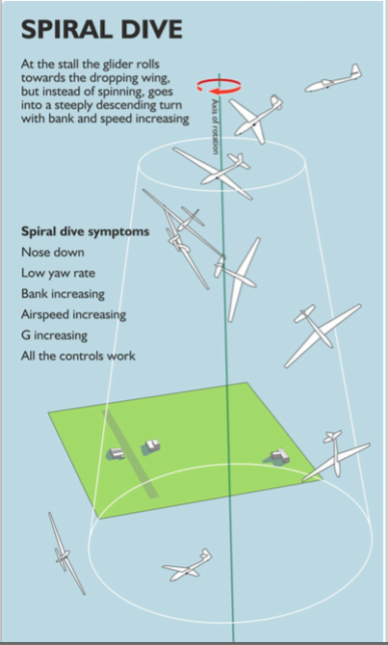
Spiral Dive – recovery technique
Roll wings level
Recover from the dive
Notes:
Sometimes a stall will not develop into a full spin.
Depending on how the stall recovery is handled, the glider can exit the stall while also dropping a wing on one side.
The result is a spiral dive.
The symptoms and recovery from the spiral dive is different to the spin.
This video shows a direct comparison of the two.

Slide 19
https://www.youtube.com/watch?v=dsVV3exXA94
Notes:
This video shows a direct comparison of the two.

Slide 20
Stall & Spin Training in Gliders
Summary
Training is intended to teach you to:
recognise the symptoms of an approaching stall and take timely avoiding action
become familiar with the characteristics of the full stall
learn how to recover with minimum loss of height
avoid inadvertent stalling & spinning by developing safe flying habits in all phases of flight
Stalling & spinning sounds dramatic but it is well understood
Exercises are conducted at height with lots of recovery margin – training is perfectly safe
Training exercises are gradual and are demonstrated over multiple flight sorties
Recovery from a Stall is simple – ease the stick forwards
Standard recoveries for Spins & Spiral Dives

