Slide 1
Thermal soaring made simple
Understand how to find a thermal and use it safely

Slide 2
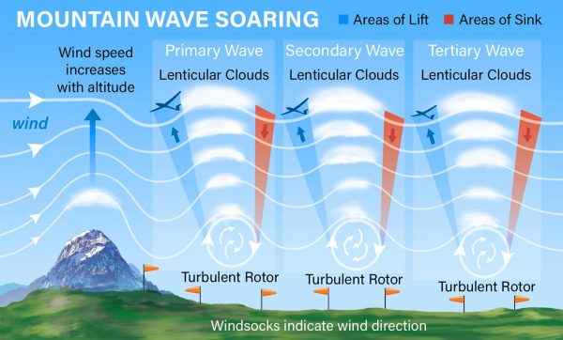
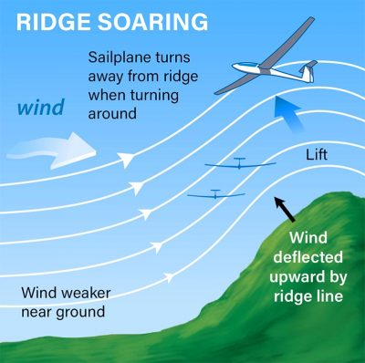
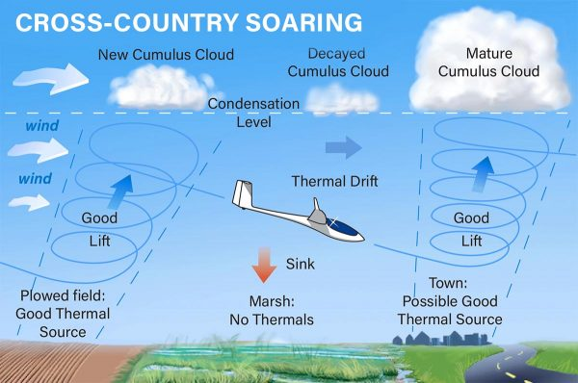
Different types of lift
Notes:
The glider is always descending, but if the air is going up faster then you are coming down then you are going up!

Slide 3
Aim for one of these!

Slide 4
Speed to fly?
Notes:
Approaching the thermal slow down if glass, first get the sink then the lift , Look OUT!!!! in wood count to 4 in glass start the turn gently then tighten if increases. Which wing went up?

Slide 5
Situation vacant?
What are the rules/guidelines:-
Notes:
Best vario in the world is another glider going up faster than you are. Don’t be frightened about joining but practice with an instructor.

Slide 6
Gliders in the thermal have the right of way
All gliders should circle in the same direction
If gliders are circling in different directions circle the same as the nearest vertical one
No glider in the thermal shall have to get out of your way when you join.

Slide 7
Joining
Notes:
Beware of high performance pull ups.

Slide 8
Perfect join
Notes:
Off to one side, don’t pull up violently

Slide 9
Staying in
Notes:
As the lift increases gently tighten and as it decreases gently ease off. Hold a steady speed and attitude until you can see what is happening. Trim right back top rudder a fraction. Lean into the entry at first.

Slide 10
Staying safe
Keep your distance
Notes:
Look out cycle, aim for the tail never the nose, if in doubt look out and get out, you can rejoin when they have climbed away, the thermal wont disappear

Slide 11
Lets get out of here!!!
Look out
Speed up
Straighten up
Notes:
Make a note on entry where something big is to exit on if possible, if not don’t worry, leave when you get close to cloud or the lift is dropping off

