Slide 1
Defining Turnpoints
Using seeyou mobile and an oudie
Jon Hall

Slide 2
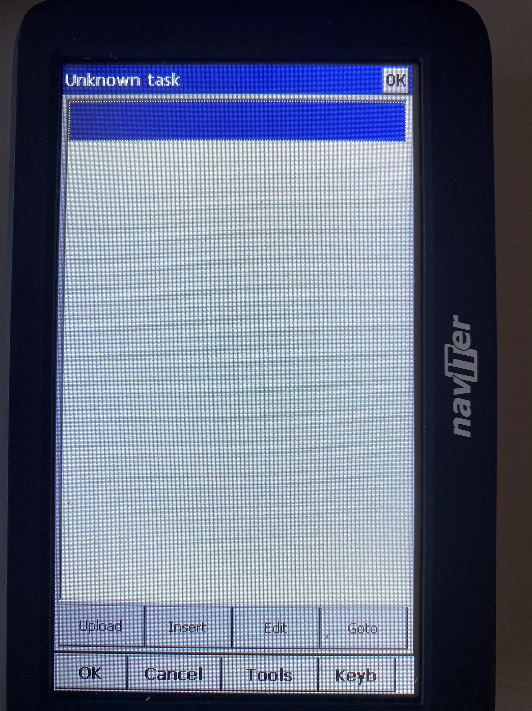
Defining Turnpoints
Select the TASK button
from MAIN MENU
You’ll be presented with a blank screen
Click INSERT button

Slide 3
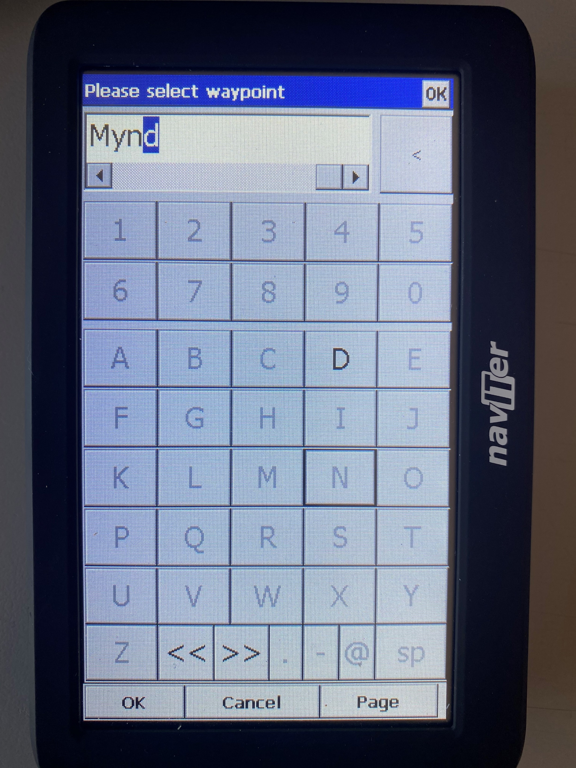
Defining Turnpoints
Type the name of the WAYPOINT
Most devices allow you to use either the full name or the TRIGRAPH
TRIGRAPHS are useful when you are working from a TASK SHEET

Slide 4
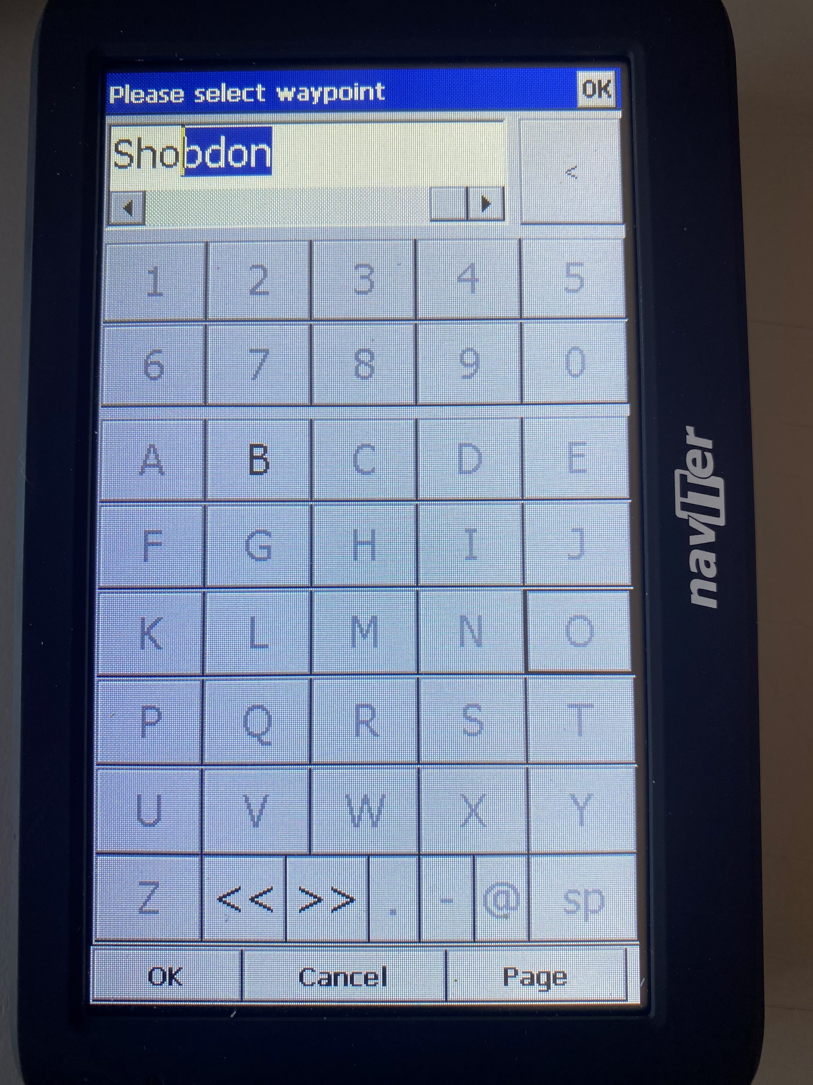
Defining Turnpoints
Usually when you click OK you will go to the next entry screen
Add the rest of the WAYPOINTS including the same start waypoint which will become the finish

Slide 5
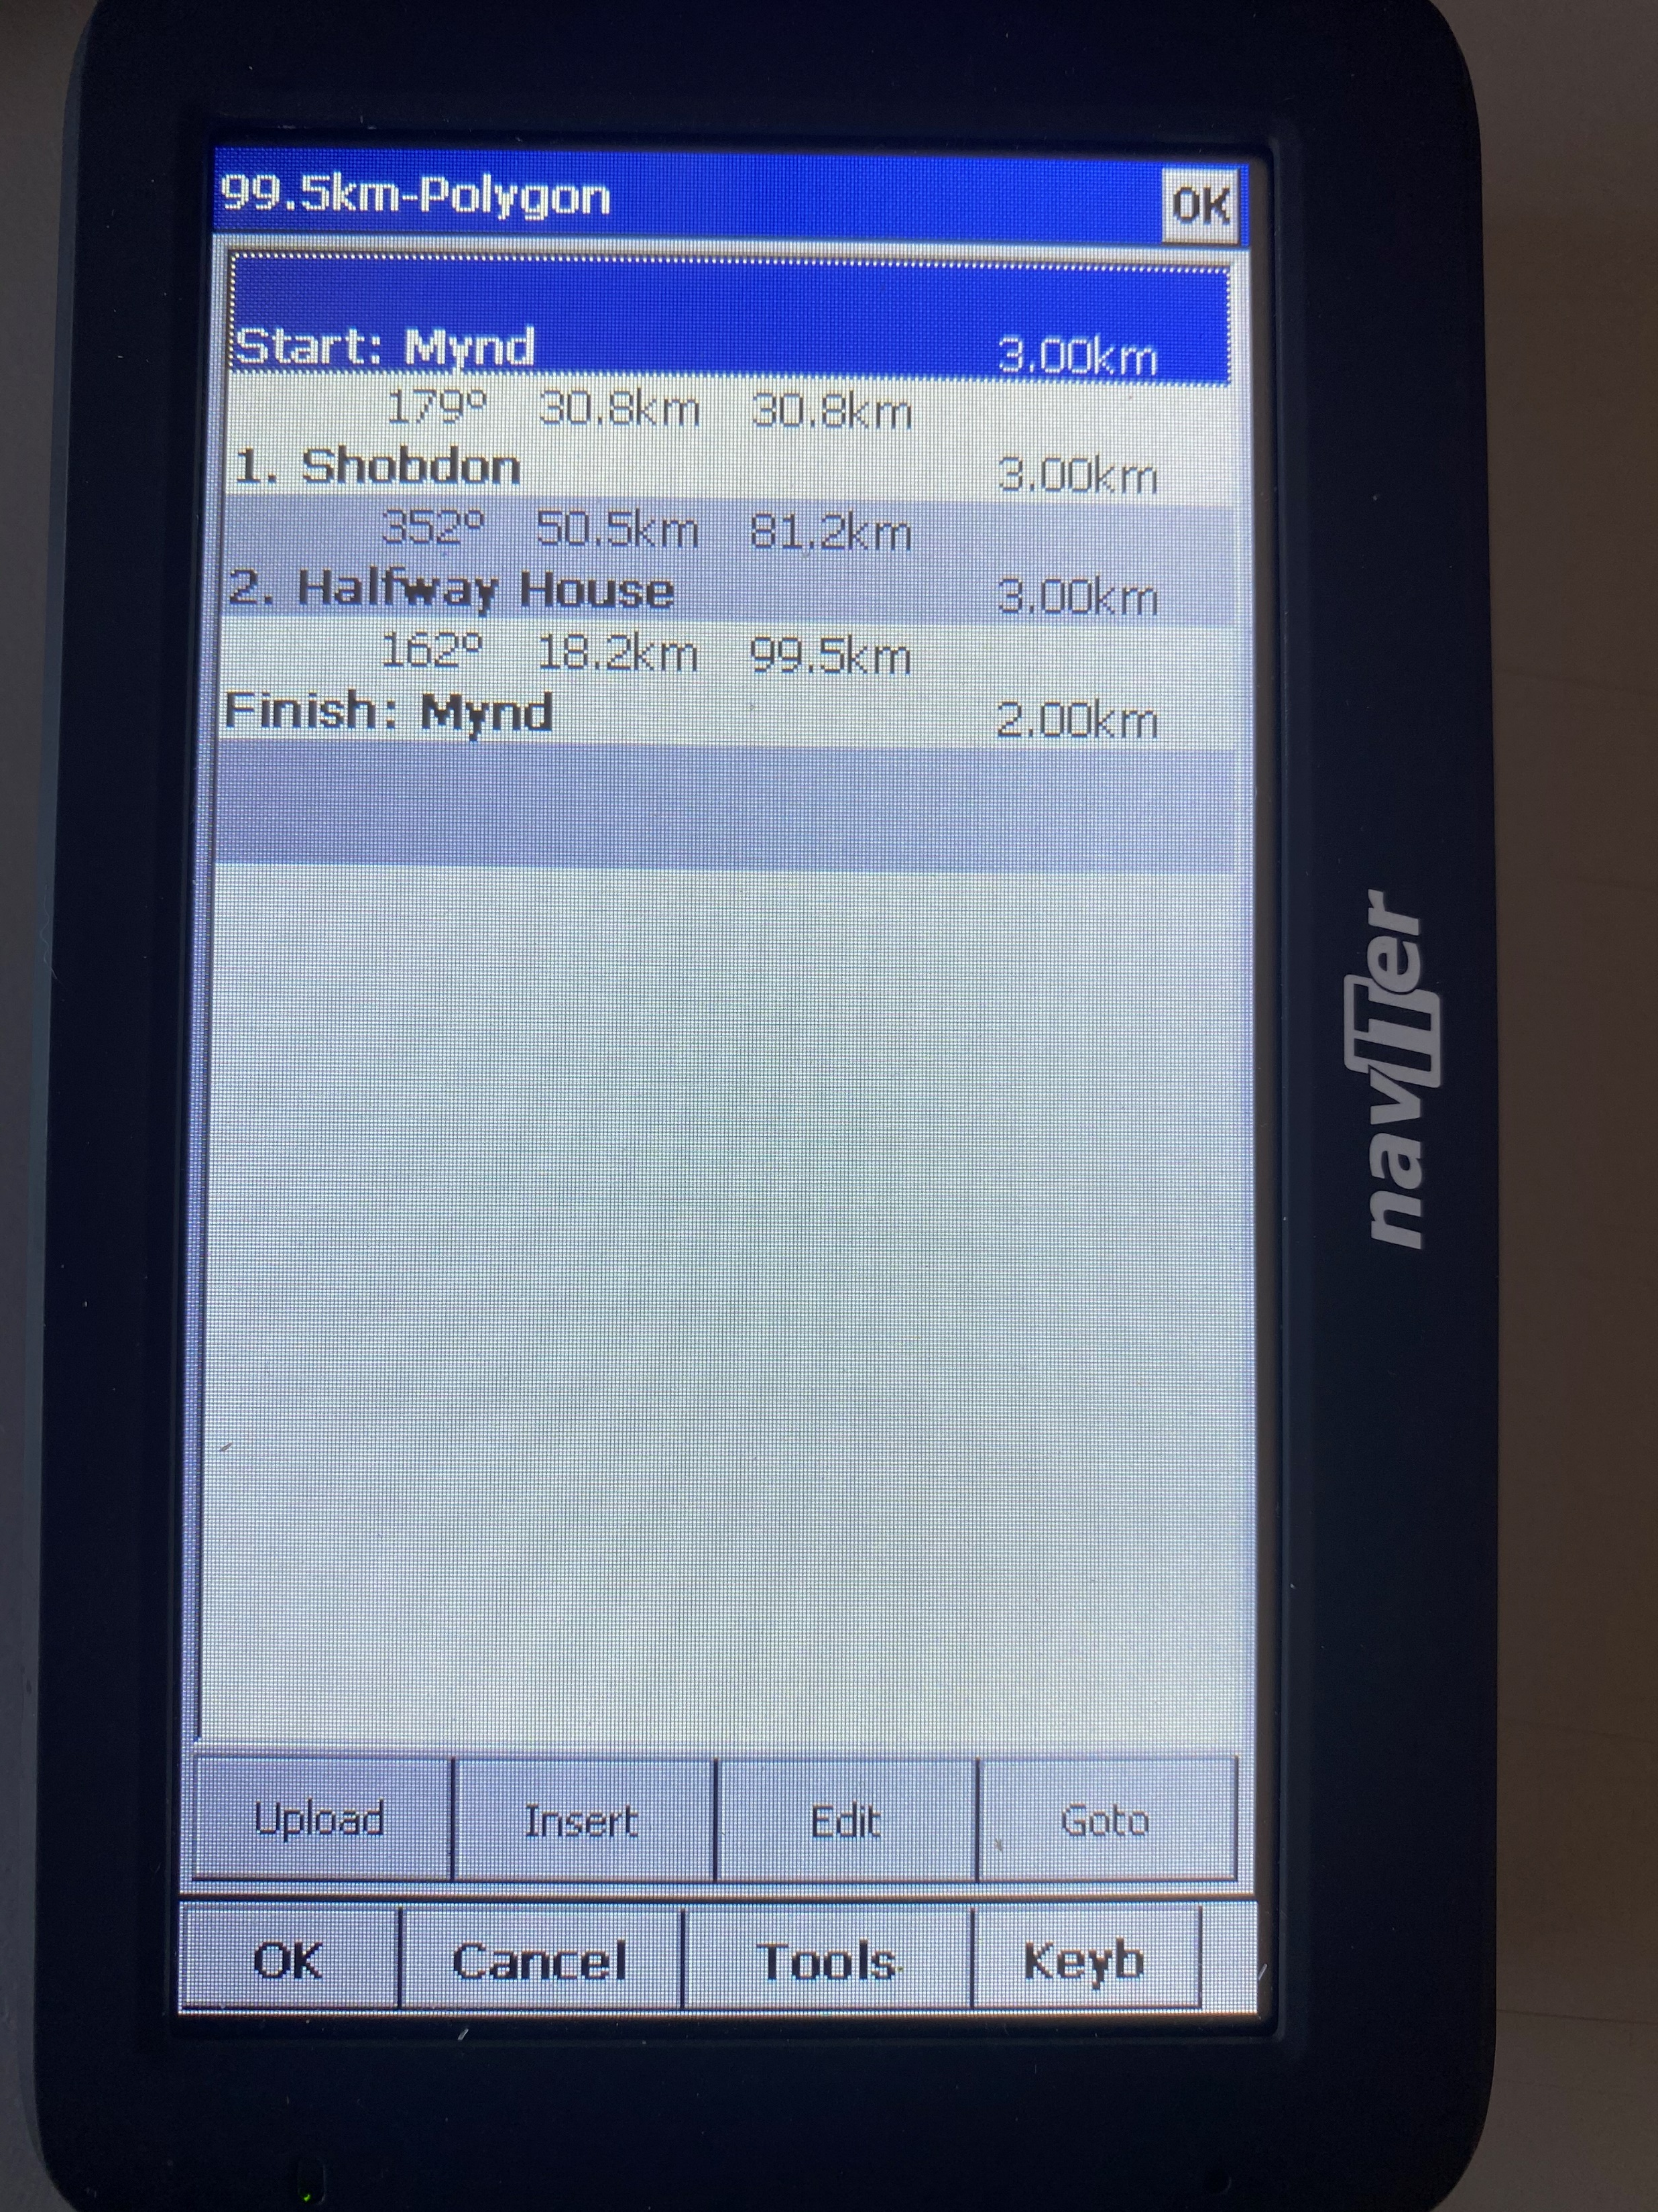
Defining Turnpoints
You now need to DEFINE each waypoint with its own characteristics
Comps will tell you the definition details
Badge Flights will be as follows
Click on the START waypoint, in this case the MYND

Slide 6
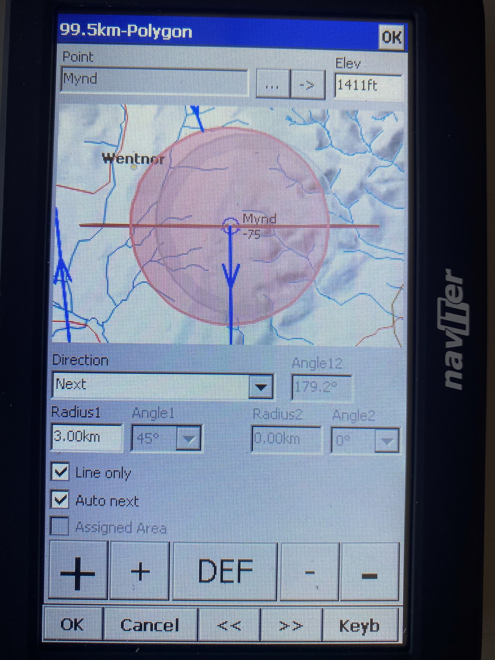
Defining Turnpoints
Select DIRECTION as NEXT
Define the length of the start line
Tick the LINE ONLY box
Tick the AUTO NEXT box
To change the waypoint click on the EDIT button, marked by three dots

Slide 7
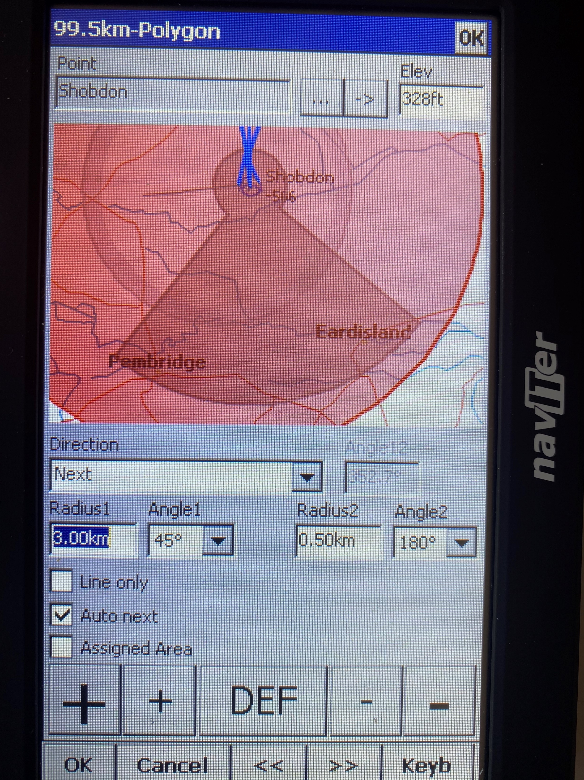
Defining Turnpoints
For each waypoint you can define the ANGLE , the DISTANCE and if the competition defines VARIABLE BARRELS, as many now do, the ANGLE2 and RADIUS2 of the variable barrel.

Slide 8
Defining Turnpoints
Define the FINISH as either a line or a circle and the radius
You can if you wish define the DIRECTION as FIXED or PREVIOUS

Slide 9
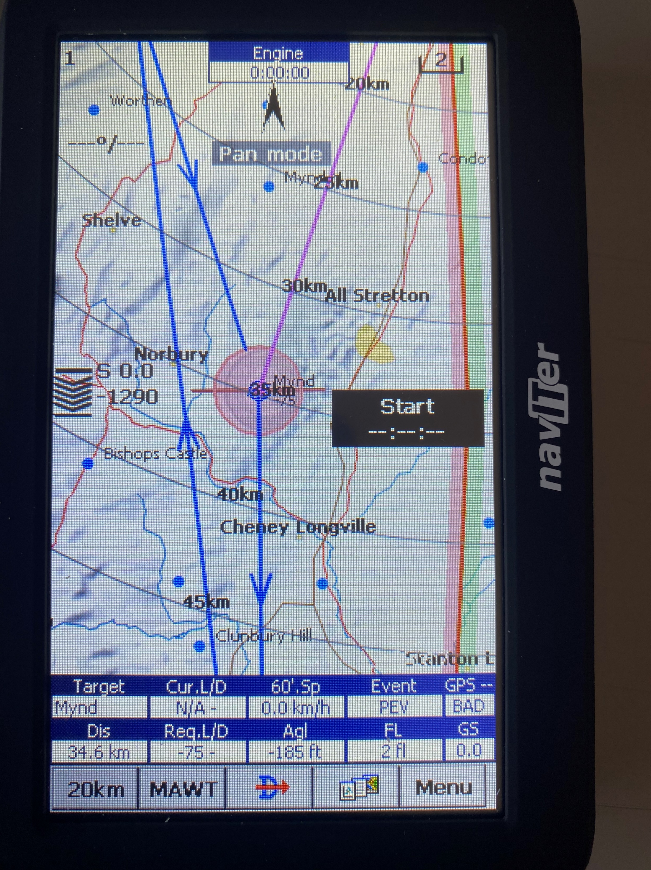
Defining Turnpoints
When you have entered all the waypoints go back to the map and check that it looks right
It’s a good idea to ask someone else to do a sense check for you
If it’s a badge flight ask an instructor, coach or Official Observer to check it for you

Slide 10
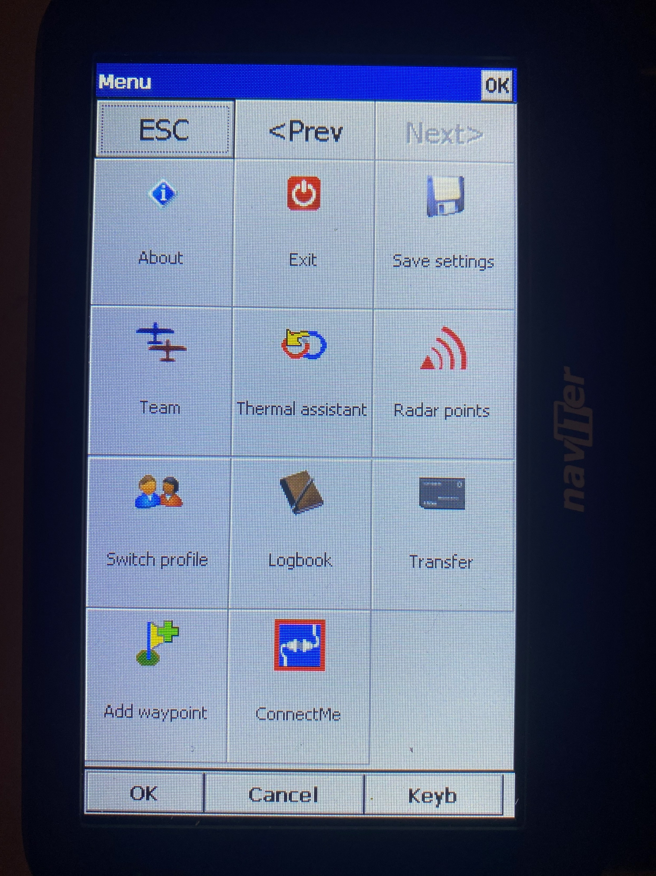
DON’T FORGET TO SAVE YOUR SETTINGS BEFORE EXITING
Or you may lose them
and have to do it
all over again

