Slide 1
THE FLIGHT ENVELOPE
WHY WE NEED TO DEFINE LIMITS
THE MANOEUVRING ENVELOPE
DESIGN DIVE SPEED
MANOEUVRING AND ROUGH AIR
GUSTS AND LAUNCHING STRESSES
PLACARD LIMITS
ALTITUDE
FLAPS / AIRBRAKES

Slide 2
THE FLIGHT ENVELOPE
WHY WE NEED THESE DEFINED LIMITS
Material limitations
Acceptable load
Damage load
Failure load
Pilot limitations
Complex loads in turns
Air movements
Landing shocks

Slide 3
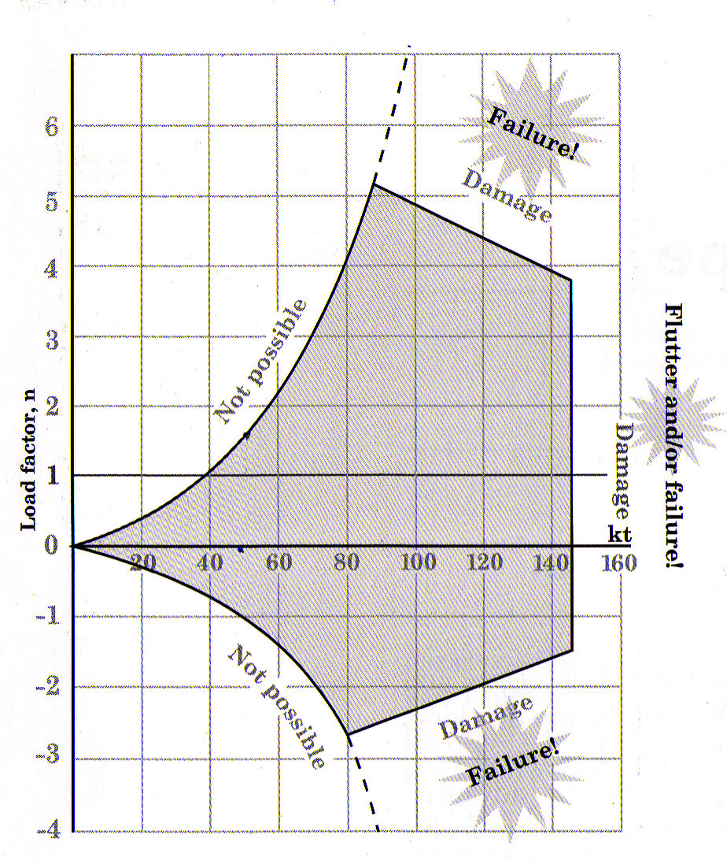
THE FLIGHT ENVELOPE

Slide 4
THE FLIGHT ENVELOPE
Design Speeds
VDf
VD
VNE

Slide 5
THE FLIGHT ENVELOPE
MAX MANOEUVRE
VA
5.3G
Full deflection of any ONE control - Va
Always same or higher than Vb

Slide 6
THE FLIGHT ENVELOPE
Rough air speed - Vb
Vb
+29knt
+14.6knt
GUST LINE

Slide 7
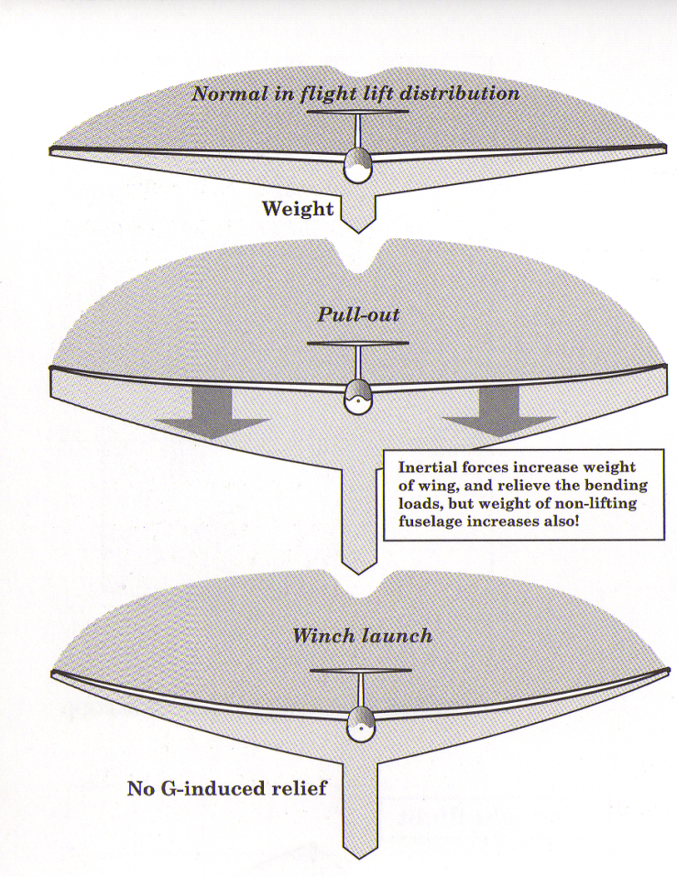
THE FLIGHT ENVELOPE
G Relief - increasing weight offsets increased load
So Vw (Max Winch)is calculated to ensure the glider is not overstressed on launch

Slide 8
THE FLIGHT ENVELOPE
The Aircraft Placard
Velocities
Vne (Never exceed )
Va ( Max Manoeuvring )
Vb (Rough Air)
Vw / Vt ( Max winch and max aerotow)
Weights
Aerobatic Category

Slide 9
THE FLIGHT ENVELOPE
Effect of Altitude
ASI measures air not speed
Air gets thinner so ASI underreads
1.5%/1000ft
Lift is function of air density
Flutter (Dg300)is related to air velocity not density(amount)
Vne is a fixed value, not related to air density

Slide 10
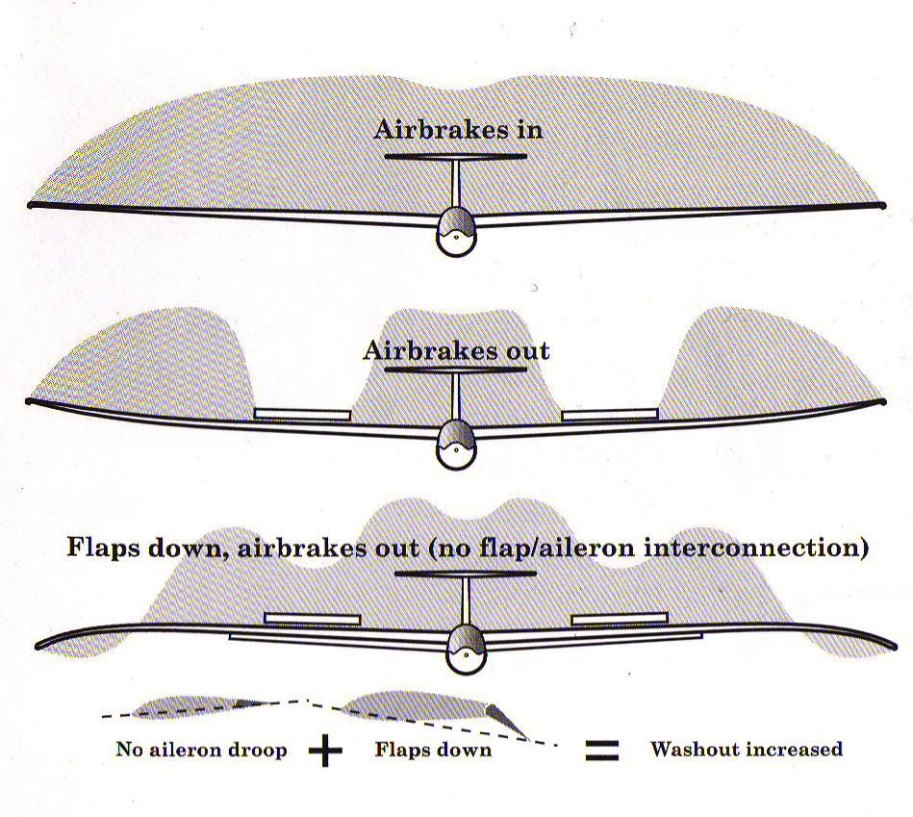
THE FLIGHT ENVELOPE
Effect of Airbrakes / Flaps

Slide 11
THE FLIGHT ENVELOPE
WHY WE DEFINE LIMITS
THE MANOEUVRING ENVELOPE
DESIGN SPEEDS
MANOEUVRING AND ROUGH AIR
GUSTS AND LAUNCHING STRESSES
PLACARD LIMITS
ALTITUDE
FLAPS / AIRBRAKES
QUESTIONS

